Slide 1
Professions, occupations and
training pathways in Germany
Vocational education
and training in Germany

Slide 2
Contents
Occupational fields in Germany
The German Qualifications Framework (DQR)
Two types of initial training
Company-based training in the dual system
School-based training
Opportunities for continuing training and career advancement
Notes:
Further information
> Overall, approximately 50% of the population have started dual VET at some point in their lives.
> The employment rate is high. Approximately 96% of all persons completing VET find employment (compared to 82% without a vocational qualification).
The positive effect
Youth unemployment in Germany is
only around 5%

Slide 3
















1. Occupational fields in Germany
Agriculture, nature, environment
Business, administration
Production, manufacturing
Transport, logistics
Construction, architecture, surveying
Services
Metal working, engineering
Health
Electrical
Social, pedagogy
IT, computers
Social sciences, humanities
Natural sciences
Art, culture, design
Technology, fields of technology
Media

Slide 4
2. The German Qualifications Framework (DQR)
An instrument for the alignment of qualifications in the German education system
Orientation and transparency
of qualifications and
competencies
Eight reference levels which correspond to the European Qualifications Framework (EQF)
Creates international comparability
Ensures greater occupational mobility in Europe
Notes:
Difference between the EQF/DQR
EQF
Each of the 8 levels describes 3 “columns”: knowledge / skills / responsibility and autonomy
Higher degree of abstraction than the DQR
A meta framework, overarching transparency instrument, aims to be able to relate different national education systems to one another.
DQR
Each of the 8 levels describes 4 “columns”. Professional competence: knowledge / skills. Personal competence: social competence / autonomy.
The aim is to map all the aspects of employability skills in a more appropriate way. The emphasis is placed on a holistic definition of competency.
Each reference level has a brief introductory text which summarises the requirements structure of the respective level (“level indicator”).
Expands and substantiates the EQF.

Slide 5
2. The German Qualifications Framework (DQR)
Systematisation by degree of complexity and type of task
DQR 1-2
DQR 3
DQR 4
No training – unskilled tasks
Dual (= company-based) training occupation (2 years)
Dual (= company-based) training occupation (3–3.5 years)
e.g. harvest worker, kitchen assistant/assistant cook, relief waiter, electrician’s assistant*
e.g. specialist in the hospitality services industry, warehouse operator, construction finishing worker, sales assistant for retail services, skilled metal worker*
e.g. farmer, cook, warehouse logistics operator, mechatronics engineer for refrigeration technology, plant mechanic
or: (full-time) school-based training occupation
e.g. agricultural technical assistant, food technical assistant, hotel management assistant, technical commercial assistant in buildings services, mechatronics assistant – specialising in maintenance and service*
* The occupations within the same occupational field stated here do not necessarily build upon one another.
They represent occupations at the different reference levels in the respective occupational field which are cited as examples.
Notes:
DQR – general education qualifications
Lower secondary school leaving certificate – DQR 2
Intermediate secondary school leaving certificate – DQR 3
University of applied sciences entrance qualification, subject-restricted higher education entrance qualification, general higher education entrance qualification – DQR 4
Bachelor’s degree (degree from a university of applied sciences, state examination) – DQR 6
Master’s degree (Diplom from a university, Magister degree, state examination) – DQR 7
Doctorate and equivalent arts qualifications – DQR 8

Slide 6
2. The German Qualifications Framework (DQR)
Systematisation by degree of complexity and type of task
DQR 5
DQR 6
Specialised
higher qualification
Upgrading training leading to a
qualification at master craftsman level
or: Upgrading technical
training
e.g. certified professional specialist – IT specialist, service technician, dietary cook, service technician for wind turbine engineering, interior design consultant (Chamber of Industry and Commerce, IHK)
e.g. Bachelor Professional, master craftsman qualification in agriculture, master chef, master craftsman qualification in restaurant management, master craftsman qualification in electrical engineering
e.g. Bachelor Professional, agricultural engineering technician,
food technology technician, building systems engineering technician
or: Upgrading commercial training
or: Academic course of study leading to a Bachelor’s degree at a university of applied sciences/institute of higher education
e.g. Bachelor Professional in Agricultural Accountancy, Bachelor Professional of Business, Bachelor Professional of Management for Industry, Bachelor Professional in Publishing, Bachelor Professional of Accounting
* The occupations within the same occupational field stated here do not necessarily build upon one another.
They represent occupations at the different reference levels in the respective occupational field which are cited as examples.

Slide 7
2. The German Qualifications Framework (DQR)
Systematisation by degree of complexity and type of task
DQR 7
DQR 8
Advanced upgrading training
or: Academic course of study leading to a Master’s degree at a university of applied sciences/institute of higher education
Doctorate
at an institute of higher education
e.g. Master Professional in Technical Business Management, Master Professional in Commercial Business Management, Master Professional of Vocational Training*
e.g. Doctor of Agricultural Sciences (Dr. agr.), Doctor of Economics (Dr. oec.), Doctor of Nutritional Science (Dr. oec. troph.), Doctor of Engineering (Dr. Ing.)*
e.g. Master of Science (MSc.) in Agriculture*
* The occupations within the same occupational field stated here do not necessarily build upon one another.
They represent occupations at the different reference levels in the respective occupational field which are cited as examples.
Notes:
The terminological differences between the Universities of Applied Sciences and other institutes of higher education have become very unclear.
Fachhochschule / FH = Hochschulen für Angewandte Wissenschaften / HAW = university of applied sciences
Usually a wider range of subjects
Other “institutes of higher education” = universities
The main difference legally is that universities offer doctorates.

Slide 8


3. Two types of initial training
Dual training
School-based training
70% company – 30% vocational school
Training allowance
Governed by federal laws
328 occupations*, including approximately:
  130 craft trade occupations
  250 industrial and technical occupations (some of which are identical to craft trade occupations)
  50 commercial occupations
Large proportions of company-based practical phases in some cases
Training allowance paid in the healthcare sector/otherwise no allowance or fees payable
Governed by laws of the federal states
Approx. 70 occupations in the areas of:
  Technology
  Foreign languages
  Design
  Commercial occupations
  Healthcare, social sector, body care
* Overlaps in some cases
Notes:
Teaching now also frequently takes place in the form of scheduled blocks.
Cooperative training
A company which is unable to offer all training contents joins forces with one or more partner companies to deliver training together.
Overall responsibility for the training rests with the coordinating company, with which the trainee concludes a contract. The coordinating company also pays the training allowance.
Trainees must work and learn at the partner company for at least six months during the training.
As well as being concluded between companies, cooperation arrangements can also be made between a company and a training provider.

Slide 9

4. Company-based training in the dual system
Craft trade occupations
130 occupations which predominantly lie within the areas of responsibility of the chambers of crafts and trades, the guilds and the district craft trade associations in the following areas:
Wood-working sector
Construction and finishing trades
Electrical and metal-working sectors
Clothing, textiles and leather
Glass, paper, ceramics and allied trades
Chemical and cleaning sector
Healthcare and body care
Food
Access: no formal restrictions
Company providing training decides what prior school learning applicants will require
Around 25% of all trainees enter training in a craft trades occupation

Slide 10

4. Company-based training in the dual system
Industrial and technical occupations
Around 250 occupations (some of which are identical to craft trade occupations) in which training takes place at industrial or other major companies.
For example:
Plant mechanic
Biological laboratory technician
Chemical technician
Electronics technician for industrial engineering
Skilled metal worker
Machine and plant operator
Mechatronics fitter
Production technologist
Materials tester
Access: no formal restrictions
Company providing training decides what prior school learning applicants will require
Around 60% of all trainees enter training in an industrial and technical occupation
Notes:
The values of craft trade occupations + industrial and technical occupations do not add up to 100% because the categories sometimes overlap.

Slide 11

4. Company-based training in the dual system
Commercial occupations
50 occupations (depending on how these are counted) or more. For example in the following areas:
Trade (retail, wholesale and foreign trade, industry)
Office and administration
Finance, controlling and law (banks, insurance companies,
legal system)
Health management
Logistics and transport (forwarding and
logistics services)
Real estate
Hotels and restaurants
Leisure and tourism
Access: no formal restrictions
Company providing training decides what prior school learning applicants will require
An intermediate or higher secondary school leaving certificate is frequently demanded.

Slide 12

5. School-based training
Specialist healthcare professions
The following areas can be differentiated:
regulated professions ➔ may only be exercised by persons with a state-recognised training qualification
  Areas:
    Nursing, emergency medical services and midwifery
    Technical medical assistant occupations
    Physical and language therapy
  Further areas:
    Commercial occupations/healthcare management
    Craft trade occupations in the healthcare sector
Duration of training: usually three years
Access: usually an intermediate secondary school leaving certificate
Alongside the classical nursing professions, this category also includes the fields of speech therapy, occupational therapy and physiotherapy and the occupations of paramedic, podiatrist and dietary assistant.

Slide 13
5. School-based training
Further occupations:
Around 50 occupations with a large practical component, e.g. in the following areas:
Technical media assistant
Pharmaceutical, chemical or
technical biological assistant
Information technology assistant
Technical ship’s operations assistant
Commercial management assistant
European management assistant
European secretary
Hotel management clerk
Nursing assistant occupations
Social assistant
Creative occupations (e.g. ceramics maker, designer)
Occupations in the field of sport (e.g. performing artist, dancer, gymnastics teacher
Duration of training: one to three years (depending on whether training takes place on a full-time or part-time basis).
Access: predominantly an intermediate secondary school leaving certificate

Slide 14

5. School-based training
Higher VET pathways
Certified Professional Specialist [DQR 5]
Bachelor Professional [DQR 6]
Master Professional [DQR 7]
Period of learning 400 hours
Mainly in the IT sector
Admission after achievement of DQR 4
Period of learning at least 1,200 hours
Master craftsman qualification crafts and trades sector
  1–3.5 years
  Full-time or in-service
Technician
  Varying duration
  Full-time or in-service
Bachelor Professional qualifications
  Varying duration
  Full-time or in-service
Admission after achievement of DQR 6
Period of learning at least 1600 hours
Notes:
Example occupations
Certified Professional Specialist [DQR 5]
Certified Professional Specialist for foreign
language communication
Certified Professional Specialist for
building system integration
Certified Professional Specialist for
energy, energy efficiency and energy
management
Bachelor Professional [DQR 6]
Bachelor Professional of Accounting
Bachelor Professional in Event Technology
Bachelor Professional in Media
Master Professional [DQR 7]
Master Professional in Business Management
Master Professional in Restoration in the Craft Trades Sector
Master Professional of Vocational Training
Master Professional of IT Business Engineering

Slide 15
6. Opportunities for continuing training and career advancement
Transition to the academic branch of education
Transition from VET to academic education WITHOUT a higher education entrance qualification
Access via upgrading training
  e.g. master craftsman qualification in the craft trades (Bachelor Professional) or a comparable advanced qualification pursuant to the Vocational Training Act (BBiG) or the Crafts and Trades Regulation Code (HwO) or in the field of the healthcare professions governed by federal state law
  General access to higher education
Access on the basis of professionally relevant vocational education and training and occupational activity
  At least two years of VET followed by at least three years of practical experience in the occupation in which training has taken place or in a professionally relevant occupation
  Consultation meeting, admission examination or trial period of study may be necessary
  Access to a course of higher education study of professional relevance to the vocational qualification/occupational activity

Slide 16
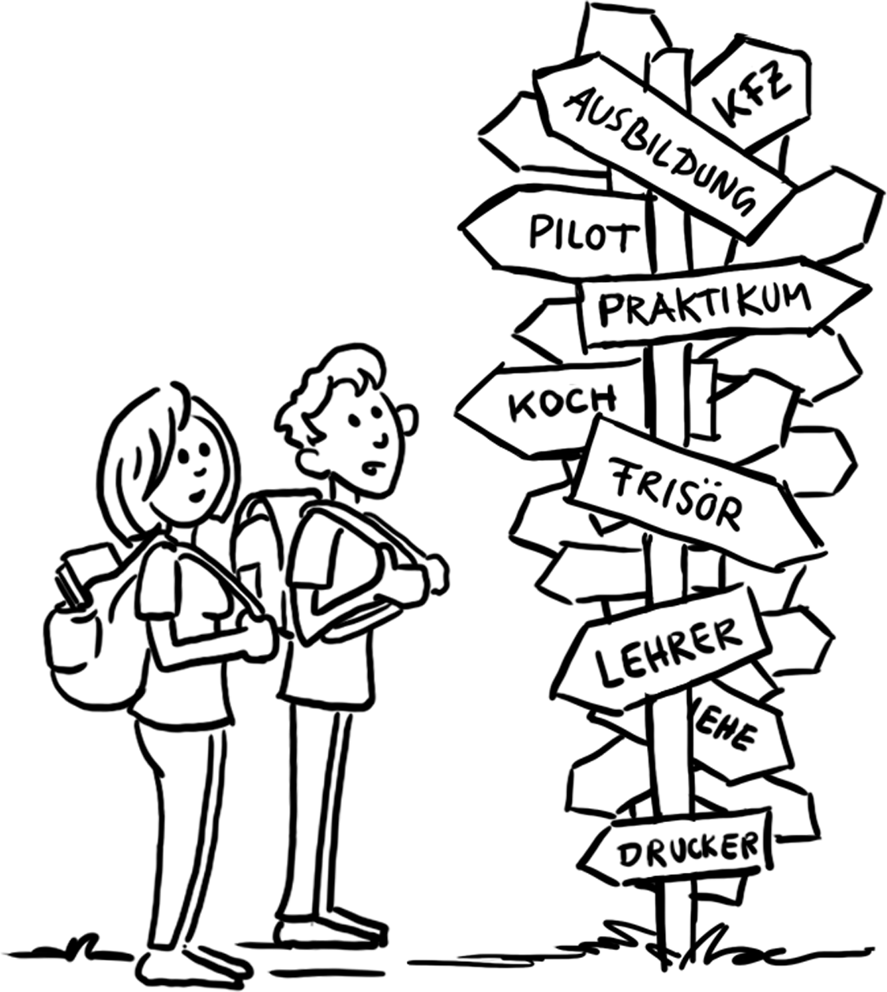
6. Opportunities for continuing training and career advancement
Other continuing training pathways
School/vocational qualifications via the second chance route
Retraining
e.g. Training for higher level tasks
On an in-service basis at evening schools, full-time or at colleges or with training providers
Training for task other than the task previously trained for and practised
For health or labour market-related reasons
Duration of training usually reduced by a third because of
the prior vocational learning

Slide 17
Further information
This presentation, further presentations and information on German vocational education and training and international VET cooperation are all available on our website at:
www.govet.international/en
Sources
BIBB Data Report (link)
KMK (link)
BMBF Data Portal (link)
Destatis statistics on VET (link)

Slide 18
GOVET at BIBB

