Slide 1
Career orientation in the German vocational education and training system: an overview
Vocational education and training in Germany

Slide 2

Contents
Basics
Career orientation in schools
Other stakeholders and programmes (examples)
    Employment agency
    Chambers
    Trade unions
    Education chains
    Girls’ Day and Boys’ Day
Benefits of career orientation
Summary/principles
Further information

Slide 3
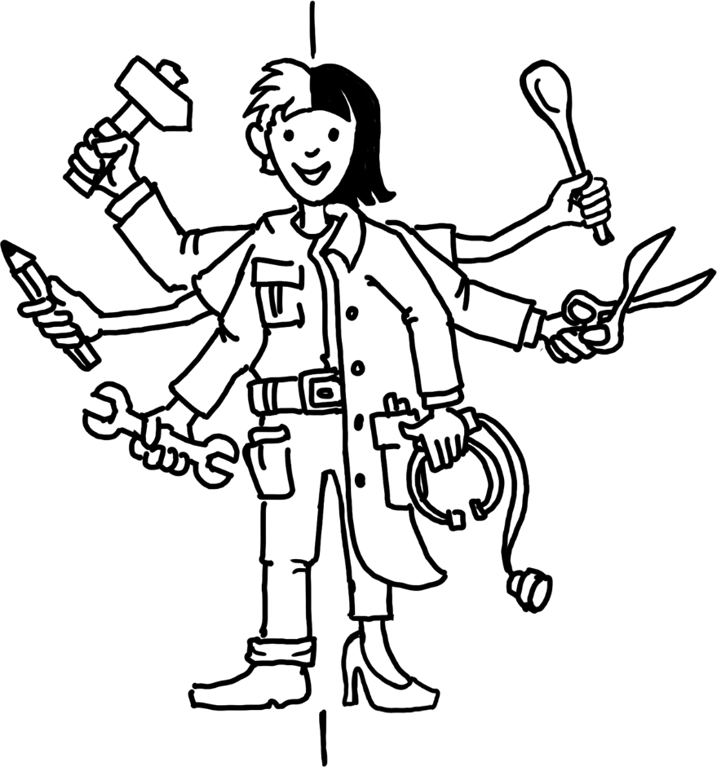
1. Basics
Definition and goals
Career orientation is a process which begins at an early stage in schools and continues through to starting training or taking up an occupation
The goal of career orientation is to enable young people to make independent and informed decisions free from stereotyped thinking.
It is focussed on nurturing the individual and on continual support for young people.

Slide 4
1. Basics
Stakeholders
A large number of stakeholders in the areas of education and the labour market are actively involved in career orientation
  Schools
  Federal states, administrative districts and municipalities
  The Employment agency
  Federal ministries (in particular the Federal Ministry of Education and Research, BMBF; and the Federal Ministry of Labour and Social Affairs, BMAS)
  Federal Institute for Vocational Education and Training (BIBB)
  Chambers, social partners, companies, private providers
  …
Coordination: Federal state coordination offices, networks, multiple joint initiatives and activities from local to national level

Slide 5

1. Basics
BIBB board recommendation on career orientation (2005)
Recommendation is focussed on
young people up to the age of 25.
Safeguarding and expanding provision
Providing resources
Training teaching and advisory staff, setting standards
Lifelong
guidance and
advisory processes
Board
Cooperation of all stakeholders
needed, regional and national
networking
Ensuring quality of provision
Involving families

Slide 6


2. Career orientation in schools
Responsibility of federal states
Basis: Recommendation of the Standing Conference of the Ministers of Education and Cultural Affairs on vocational orientation in schools
Individual policies and regulations of individual federal states
Numerous tools used, in some cases in cooperation with other stakeholders such as the Federal Ministry of Education and Research/Federal Institute for Vocational Education and Training, companies, chambers and the employment agency

Slide 7
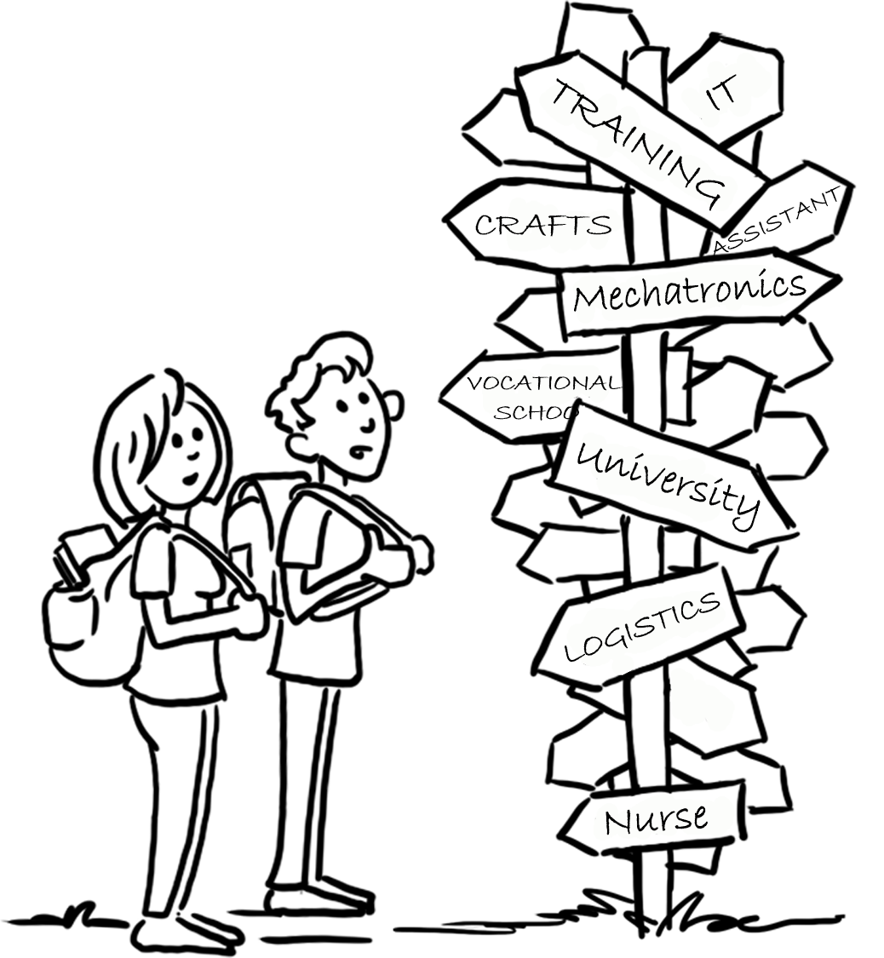
2. Career orientation in schools
Starts at ages 13–14, in some federal states ages 11–12 or earlier
Measures:
  Career-choice passport (Berufswahlpass)
  Career orientation lessons
  Orientation days in companies and work experience placements
  Offers e.g. from the employment agency
  Vocational orientation programme (BOP) of the BMBF
  …

Slide 8


2. Career orientation in schools
Career-choice passport (Berufswahlpass) and career-choice app (berufswahlapp)
Classroom tool used for over 20 years to support vocational orientation
Developed as part of digitalisation in schools, in use since 2022 in some federal states
Joint project of the Federal Ministry of Education and Research (BMBF) and the federal states
The career-choice passport/career-choice app office at BIBB is responsible for and coordinates the career-choice passport, its content development and public relations work across all federal states

Slide 9
2. Career orientation in schools
Career-choice passport (Berufswahlpass) and career-choice app (berufswahlapp)
Contents
Documents and provides opportunities for reflection on the career orientation process, e.g. work experience placements and careers guidance interviews.
Different task formats to support career orientation
Path to career choice: analysis of interests and competencies, evaluation of work experience placements and experience, documentation of the application process
Collection of information materials and documents which help pupils when making their career choices
Helps with plans for the future

Slide 10
2. Career orientation in schools
Career orientation lessons
Often an established part of the curriculum at lower secondary level (from ages 13–14),
even earlier in some federal states
Provides information about different occupational fields, training opportunities and the labour market.
Objectives: Encourages self-reflection on own interests and strengths, preparation for choosing a career.

Slide 11


2. Career orientation in schools
Work experience placements (Internships)
Voluntary work experience placements
During school holidays, pupils are able to complete additional voluntary work experience placements in order to sample additional occupational fields.
Orientation days
Pupil work experience placement
This is generally a compulsory placement
Ages 13–16, for between one and three weeks
Provides practical experience in a business and allows pupils to find out about day-to-day working life.
Long-term placements
In some cases, schools and projects also offer longer placements which involve young people working on a regular basis in a business over an extended period.

Slide 12



2. Career orientation in schools
Organisation of work experience placements
Occupational safety
Work experience placements for pupils are subject to the Youth Employment Protection Act (JArbSchG). This regulates, for example, working hours, breaks, and the nature of activities.
Supervision
Businesses are required to guide and supervise young people to ensure that the work experience placement is of educational value.
Minimum wage
Statutory regulations relating to minimum wage
do not apply to pupils on a work experience placement.
Data protection and protection of personal rights
For placement of pupils under the age of 18, approval from persons with parental authority is generally required (declaration of consent), in particular where personal data is being processed or publications are planned (e.g. photos).
Insurance
The school provides accident insurance cover for pupils
on work experience placements for the period of the placement. Companies must ensure that they are working in a safe environment.

Slide 13

2. Career orientation in schools
Employment agency provision in schools
School visits
Employment agency careers advisers regularly visit schools to offer individual careers guidance interviews.
Materials
Schools use materials developed by the employment agency.
Career choice tests and assessment centre
In cooperation with the employment agency and other providers, schools frequently offer tests and workshops to support career orientation.
Careers guidance centre visits
Classes visit the careers guidance centre (Berufsinformationszentrum, BIZ) to find out about occupations, training pathways and opportunities for study.

Slide 14


2. Career orientation in schools
Vocational orientation programme of the Federal Ministry of Education and Research
Ages 12 to 13
Process
Analysis of potential
Practice-oriented days in training centres on vocational orientation
Reflection and feedback
Implemented by BIBB with the Chambers at approximately 3000 schools
Integrated in regional policies

Slide 15
2. Career orientation in schools
Vocational orientation programme of the Federal Ministry of Education and Research
Analysis of potential:
Discovery of social, personal and
methodological skills
1–2 days
Currently primarily activity-oriented
(observed tasks based on assessment
centre)
Practical careers guidance days:
Exploration of occupational field in inter-company vocational training centres
5–10 days
Choice of at least 2 occupational fields
  Supporting measures
      Preparatory discussion
      Individual feedback

Slide 16
2. Career orientation in schools
Important aspects
Preparation, follow-up and discussion of experience on the vocational orientation programme are highly relevant in terms of effectiveness of measures
Individual factors are particularly relevant, individualised measures are particularly effective
If prepared, career field explorations are effective in terms of self-knowledge and curiosity regarding occupations
Reflection and feedback are key in terms of the effectiveness of measures
Conversations and perceived support appear to have very positive effects in the career orientation process
The effects diminish after 2 to 4 weeks  repeated interventions needed

Slide 17

3. Other stakeholders and programmes
Federal Government spending on various measures in connection with career orientation in 2023
Ministry/authority | Action | Amount in euros
(BMBF) | Measures to improve career orientation | 63 million
(BA) | Career orientation measures | 67 million
(BA) | Course fees for pre-vocational training measures | 187 million
(BA) | Introductory training | 17 million
(BA) | Support with transition into the labour market for young people | 59 million
Total | 393 million
Source: BIBB 2024 Data Report

Slide 18

3. Other stakeholders and programmes
Federal Employment Agency (BA)
Career orientation is a statutory duty of the Federal Employment Agency
Nationwide offers for all age groups
Advisor network
Events in schools, in the employment agency or in other locations
Advice offers, individual careers guidance interviews
Careers guidance centres throughout Germany
Information materials: print, online, some interactive
Networking with other stakeholders

Slide 19




3. Other stakeholders and programmes
Chambers
Print and online products, information events
Advice
Apprenticeship exchange (online platforms)
Training fairs and matching events
Arrangement of work experience placements
Working with schools
  Career information days
  Company visits
  Workshops
National information and image campaigns

Slide 20







3. Other stakeholders and programmes
Trade unions
Partners for schools
  Projects
  Teaching and learning provision
  Materials
Information offers, advice for young people
Seminar offers for disseminators
Political support, e.g. using surveys of young people, statements, etc.

Slide 21

3. Other stakeholders and programmes
Regional coordination offices
Run by the federal states, often at the local level
(administrative district, municipality)
  Implementation of federal state policies with a regional perspective
Coordination and participation of all local stakeholders (schools, chambers, trade unions, companies, etc.)
Services for all stakeholders
Create transparency
Organisation of events, e.g. coordinated exploration of vocational fields, course of study orientation days, dual training days, etc.

Slide 22

3. Other stakeholders and programmes
The Education Chains Initiative
The Education Chains initiative supports young people in completing their
school leaving certificate, finding a training position and obtaining their
professional qualification.
Developed by the Federal Ministry of Education and Research (BMBF) in conjunction with the Federal Ministry of Labour and Social Affairs (BMAS), the Federal Employment Agency (BA) and the federal states
Objective: Seamless transition from school into training and work
Elements of education chains:
  Vocational orientation: support with making career choices and with pre-vocational training while at school
  Transitional sector: preparatory measures and support offers between school and training, e.g. support with transition into the labour market, ASAflex (Assistierte Ausbildung flexibel [flexible assisted training]), Career Orientation for People from Refugee and Migrant Backgrounds (BOFplus)
  Training support: Individual support during training to improve training success and to avoid drop-outs (e.g. VerAplus coaching programme for improving training outcomes)

Slide 23
3. Other stakeholders and programmes
Regional coordination offices
Launch of the initiative “Graduation and continuation – Education chains
up to the vocational training qualification” in 2010 by the BMBF
Central cooperation model of the federal government (BMBF, BMAS), the Federal Employment Agency and the federal states
Coordination of funding measures and targets for providing continuous support and a chain of funding from school through to successful completion of the training qualification
Governance
  Agreements between the federal government, the federal states and the Federal Employment Agency
  Federal Government-Federal State-Federal Employment Agency Support Group
  Specialist support: Education Chains service office at BIBB

Slide 24


3. Other stakeholders and programmes
Girls’ Day and Boys’ Day
Top 10 dual training occupations based on new contracts in 2023
Men
Women
Motor vehicle mechatronics technician
Information technology specialist
Electronics technician
Plant mechanic for sanitary, heating and air conditioning systems
Industrial mechanic
Sales assistant for retail services
Retail services clerk
Warehouse logistics operator
Mechatronics fitter
Industrial clerk
Office manager
Medical assistant
Qualified dental employee
Sales assistant for retail services
Industrial clerk
Retail services clerk
Clerk in public administration
Specialist in the hotel business
Hairdresser
Tax clerk
39% of all new contracts
52% of all new contracts

Slide 25

3. Other stakeholders and programmes
Girls’ Day
National action day
Provides young girls (from age 11) with the opportunity to find out about traditionally
male-dominated occupational fields (< 40% women)
e.g. occupations in the areas of engineering, IT, the skilled trades and science
Programme for the day:
  Business visits: Girls visit companies, research centres, universities and institutions to gain an insight into
  day-to-day working life.
  Workshops and hands-on activities: Practical activities allow participants to get involved themselves and to
  test out their skills in the occupations presented
  Information events: Experts provide information on career pathways, training opportunities and future
  prospects in STEM occupations (Science, Technology, Engineering and Mathematics).
Stakeholders: Network comprising federal government, federal states, business, unions
 All companies and institutions with a registered office in Germany can participate, see Girls' Day (girls-day.de)

Slide 26

3. Other stakeholders and programmes
Boys’ Day
National action day
Provides young boys (from age 11) with the opportunity to find out about traditionally
female-dominated occupational fields (< 40% men)
e.g. occupations in the areas of nursing, education, health and social affairs.
Programme for the day:
  Business visits: Boys visit organisations such as nursery schools, care homes, hospitals and social institutions to
  gain an insight into day-to-day working life.
  Workshops and hands-on activities: Practical activities allow participants to gain experience themselves and to
  test out their skills in the occupations presented.
  Information events: Experts provide information on career pathways, training opportunities and future prospects
  in social and educational occupations.
Stakeholders: Network comprising federal government, federal states, business, unions
 All companies and institutions with a registered office in Germany can participate, see Boys' Day (boys-day.de)

Slide 27

4. Benefits of career orientation
Benefits for young people
Benefits for companies
Social benefits
Early direction setting: early recognition of interests and strengths.
Tailored selection: companies benefit from applicants who are prepared and who have clear ideas about their career.
Reduction in youth unemployment: targeted career orientation eases the transition into the labour market.
Preventing the wrong decisions: clear career goals reduce
training drop-outs.
Less labour turnover: well informed trainees and employees remain with the company for longer.
Economic success: a young person having received good guidance contributes over the long term to economic stability and to innovation.
Targeted planning: aligning of training or degree to career goals.
Motivation and confidence: a clear career goal increases motivation for learning and confidence.

Slide 28
5. Summary/principles
  Career orientation
      An essential part of the VET system
      in Germany which is supported
      and financed by all stakeholders
  Principles of good career orientation
      Establish networks
      Coordination of and cooperation from all stakeholders
      Ensure ongoing orientation (from primary level through to the school leaving certificate and beyond)
      Include involvement of young people, facilitate individual support
      Process of reflection for young people is key
      Remove gender stereotypes
      Peer learning
      Train the teachers

Slide 29



Further information
berufenavi.de – Looking for vocational orientation?
Career-choice app (Berufswahlapp)
Career-choice passport (Berufswahlpass)
zynd

Slide 30
GOVET at BIBB

