Slide 1
Data reporting in initial and continuing vocational education
and training

Slide 2
Contents
Purpose of reporting and data management in vocational education and training (VET)
VET reporting in Germany
    Two reports
    Legal basis
    Development process
    Indicators
    Ensuring quality
Internationally proven approach: lessons learned in Ghana and Vietnam
Success factors in the VET reporting development process and recommendations
Further references and materials

Slide 3

1. Purpose of reporting and data management in vocational education and training (VET)
How can we analyse dysfunctional aspects in a VET system?
How many young people are engaged in vocational education and training?
How many companies offer vocational education and training?
How effectively is a VET system working?
In which regions is VET demand greater than supply?
Which data sources can be used for reporting?
What are the requirements for future VET programmes?

Slide 4
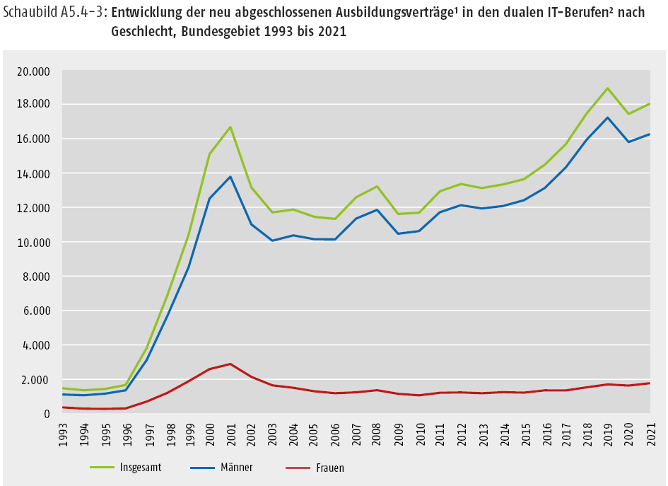
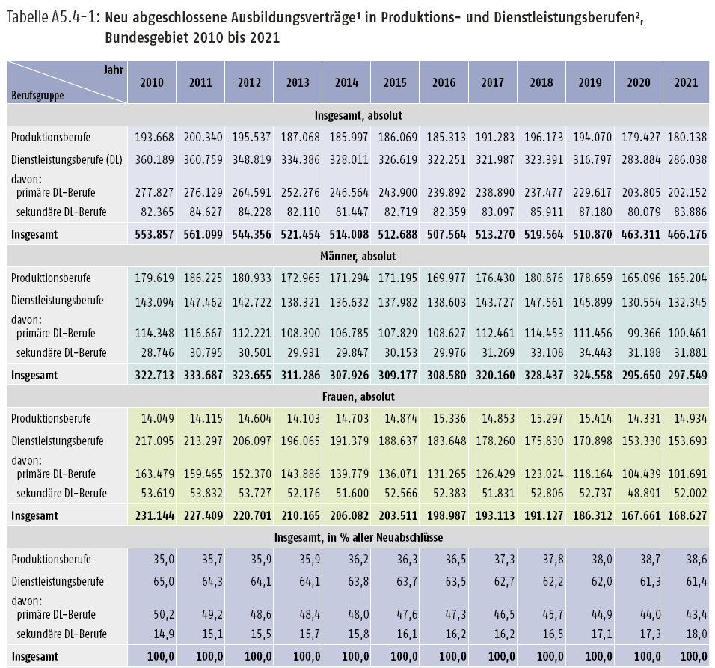
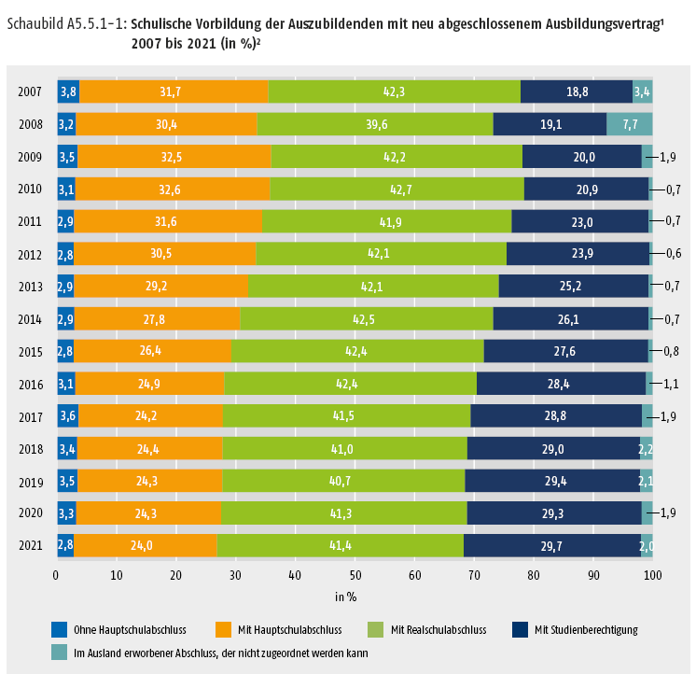
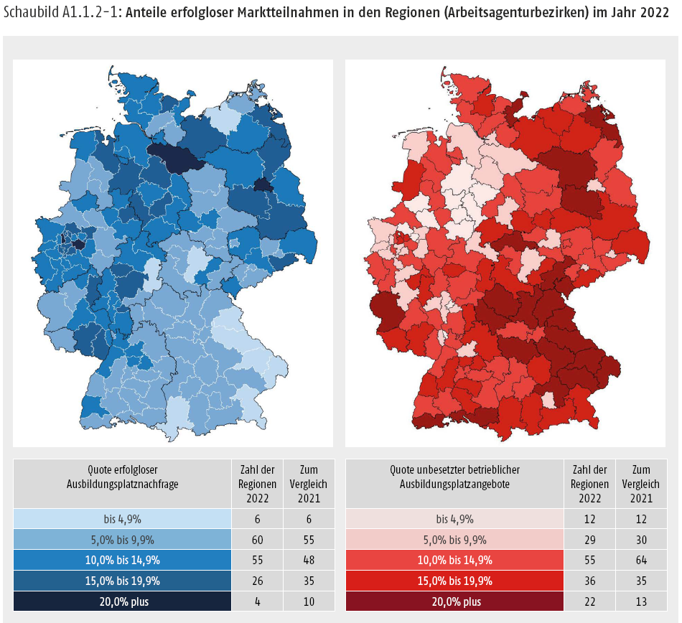
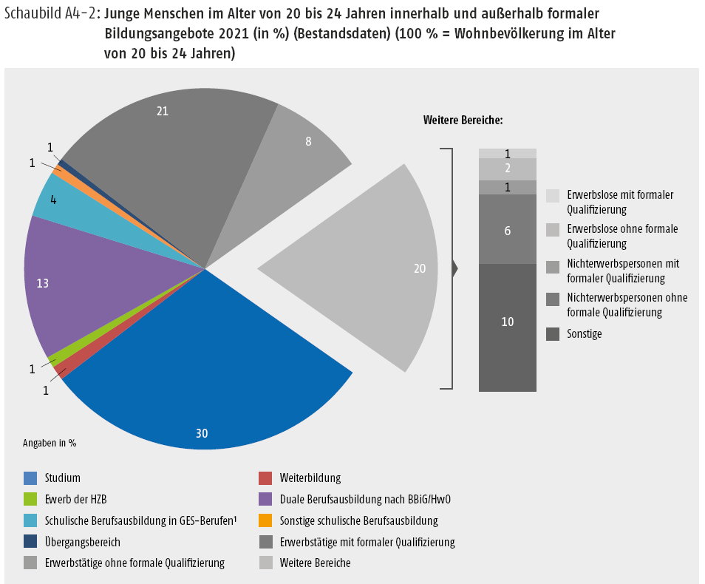
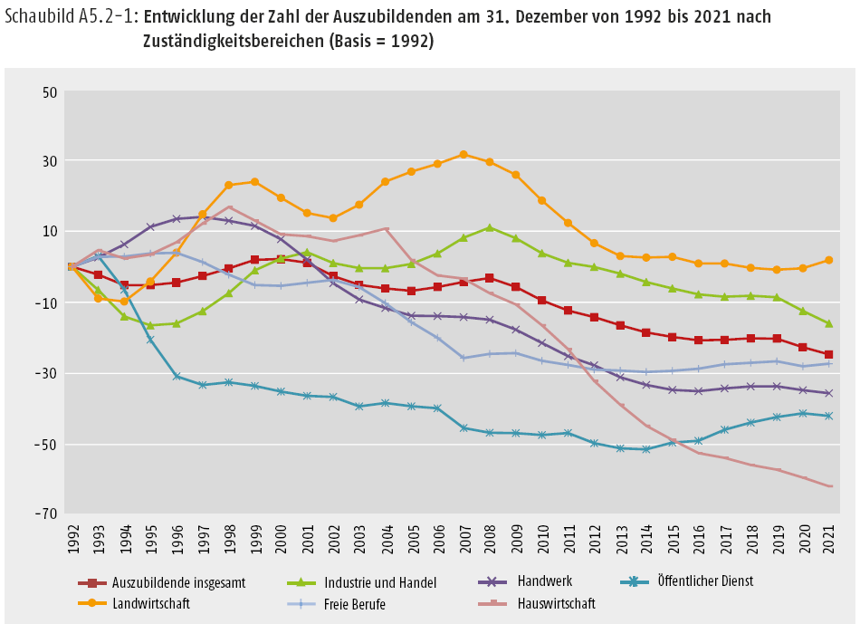
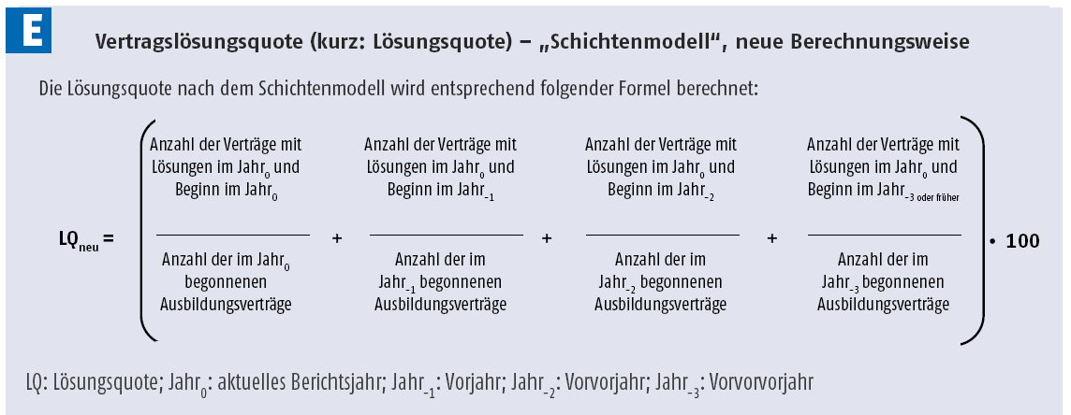
1. Purpose of reporting and data management in vocational education and training (VET)
Highlights from the Data Report to accompany the Report on VET (BIBB 2024)
* Source: Bundesinstitut für Berufsbildung [Federal Institute for Vocational Education and Training] (Ed.): Data Report to accompany the Report on Vocational Education and Training 2024.
Information and analyses on the development of vocational education and training Bonn 2024 (bibb.de/datenreport/de/189191.php)

Slide 5
1. Purpose of reporting and data management in vocational education and training (VET)
Highlights from the Data Report to accompany the Report on VET (BIBB 2024)
1.22 million
101.8
2022 trainees
(1.25 million in 2021)
Ratio of supply and demand in vocational education and training (2023)
Where do these
figures come from?
From the data report!
73,400
489,183
Training
vacancies (30.09.2023)
new training contracts
(as at 30.09.2023)
90.9
Successful final examinations (2022, in percent)
118
Updated training regulations and
68.9
Percentage of successful applications from
young people applying for VET.
(Progression or participation rate, EQI, 2023, in percent)
6
new training regulations
defined (since 2013)
* Source: Bundesinstitut für Berufsbildung [Federal Institute for Vocational Education and Training] (Ed.): Data Report to accompany the Report on Vocational Education and Training 2024. Information and analyses on the development of vocational education and training Bonn 2024 (bibb.de/datenreport/de/189191.php)
Notes:
Number of trainees in one of the 327 occupations recognised under the BBiG/HwO (2021: 1.26 million; 2019: 1.33 million), plus trainees in the school-based vocational training system and under state regulations (just under 220,000 people started in 2023).
The number of new training contracts was 475,100 in 2022, 473,064 in 2021 and 525,039 in 2019 before the coronavirus pandemic.
A total of 124 training occupations have been reorganised since 2013. These included 118 modernised and six new training occupations.
The supply-demand ratio (SDR, here in its expanded definition) was 101.8 in 2023, thus exceeding 100 for the second year in a row (2022: 101.6; 2021: 99.1; 2020 and 2019: 96.6 each). The SDR indicates how many training places are available per 100 applicants. This means that there are more training places than potential trainees.
The number of unfilled vocational training places rose again in 2023, by 4,600 (+6.6%) to 73,400.
The proportion of final examinations passed by all examination participants was 90.9% (2022: 91.5%; 2020: 92.3%; 2019: 92.8%).
The entry rate of young people interested in training (EQI) was also higher at 68.9 (2022: 68.0; 2021: 66.9; 2020: 64.5; 2019: 66.7). This means that the market situation for young people has improved (more details on the indicator below in the presentation).

Slide 6


2. VET reporting in Germany: two reports
Separating the Vocational Training Report into political and non-political parts
2009: BIBB board recommendation for the restructuring of the Vocational Training Report and dividing it into a:
non-political part
political part
is independent of political considerations
BIBB is responsible
is consulted upon and adopted by the federal government
BMBF is responsible
BIBB is involved in preparation of the draft report
Data Report to accompany the Report on Vocational Education and Training
The data report provides the empirical basis for the Report
on VET
Report on Vocational Education
and Training

Slide 7
2. VET reporting in Germany: two reports
Features of the Data Report to accompany the Report on VET
The Data Report to accompany the Report on VET...
... is a central data compendium,
... draws on empirical data and social research,
... is based on a scientifically-proven system of indicators,
... is supplemented by research findings and
... provides key indicators for initial and continuing VET.
Indicators illustrate the development over time (long-term monitoring,
“long series data”) and show regional differences (indicators for the
regional VET market)
The selection of indicators is guided by the availability of data and by the
key issues in education and training policy

Slide 8


2. VET reporting in Germany: Legal basis
Legal basis under the Vocational Training Act (BBiG) – Part 4
Vocational training research, planning and statistics
Section 84: Objectives of vocational training research
Section 85: Objectives of vocational training planning
Section 86: Report on Vocational Education and Training
Section 87: Purpose and compilation of VET statistics
Section 88: Surveys

Slide 9
2. VET reporting in Germany: Legal basis
Legal basis under the Vocational Training Act (BBiG) – Part 4
Section 86: Report on Vocational Education and Training
The Federal Ministry of Education and Research must constantly track developments in vocational education and training and must submit a corresponding report (Report on Vocational Education and Training) to the Federal Government by 15 May each year.
The report shall describe the current state and probable further development of vocational education and training.
If there are indications that a regionally and sectorally balanced supply of initial training places may be at risk, the report shall include proposals for remedying such a situation.

Slide 10
2. VET reporting in Germany: Legal basis
Legal basis under the Vocational Training Act (BBiG) – Part 4
Section 86: Report on Vocational Education and Training
As a rule, the report must specify
1. for the preceding calendar year
on the basis of the data furnished by the competent bodies, the initial training contracts entered in the Register of Initial Training Relationships under this Act or under the Crafts and Trades Regulation Code which were concluded during the twelve months prior to 1 October of the preceding year and were still in existence on 30 September of the preceding year as well as
the number of training places offered to the Federal Employment Agency for placement which were not filled on 30 September of the preceding year and the number of persons registered with the Federal Employment Agency on that date as seeking training places;
2. for the current calendar year
the number of persons expected to be seeking training places up to 30 September of the current year,
an estimate of the number of training places expected to be on offer up to 30 September of the current year.

Slide 11
2. VET reporting in Germany: Legal basis
Legal basis under the Vocational Training Act (BBiG) – Part 4
Section 87: Purpose and compilation of vocational training statistics
Federal statistics are compiled for the purposes of planning and organising vocational education and training.
The Federal Institute for Vocational Education and Training and the Federal Employment Agency support the Federal Statistical Office in the technical and methodological preparation of the statistics.
The surveying and processing programme must be designed in agreement with the Federal Institute for Vocational Education and Training in such a manner that the data compiled can be used for planning and organising vocational training within the scope of the competencies defined in a given case.

Slide 12
2. VET reporting in Germany: Legal basis
Legal basis under the Vocational Training Act (BBiG) – Part 4
Section 88: Surveys
The annual federal statistics comprise
for each training contract: a) sex, year of birth, nationality of trainees, b) official municipality code of trainees’ place of residence at the time of conclusion of the contract, c) general-education school-leaving certificate, previous participation in prevocational or basic vocational education and training, previous initial training and previous course of studies of trainees…
for every instance of participation in a VET examination, with the exception of the training contracts covered by no. 1: sex, year of birth and prior learning of the examinees, occupational sector, repetition of the examination, type of examination, success in the examination
for every trainer:
sex, year of birth, nature of their technical qualifications.
for every participant in a procedure for determining competency and every participant in a supplementary procedure...
The reporting period for surveys is the calendar year The information is collected with the data status as of 31 December of the reporting period.

Slide 13
2. VET reporting in Germany: Legal basis
Legal basis under the Vocational Training Act (BBiG) – Part 4
Section 88: Surveys
The names and addresses of the persons required to give information, sequence numbers of data sets on trainees, examinees and trainers and the company number of the training premises
The competent bodies are obliged to provide such information
The data collected [...] are processed as individual pieces of information by the Federal Statistical Office and the statistical offices of the Länder and transmitted to the Federal Institute for Vocational Education and Training for purposes of preparing the Report on Vocational Education and Training and conducting vocational training research.

Slide 14
2. VET reporting in Germany:
Development process
General procedure
In accordance with the Vocational Training Act (BBiG), the Report on Vocational Education and Training must be submitted each year by 15 May.
The scheduling for the preparation of the data report, which forms the basis of the Report on Vocational Education and Training, is determined by this deadline.
The data report provides comprehensive data and information on vocational education and training and must also be published as a draft by 15 May each year (as a PDF on the BIBB website).
It is published at a later date in printed form, taking into account feedback from the public.
Basic concept behind VET reporting:
The data report should be based on indicators and facilitate information and background analyses of long-term developments in vocational education and training. The indicators should therefore be measured over the long term.

Slide 15

2. VET reporting in Germany:
Development process
Main thematic structure of the data report
Preface from the BIBB President
Contents
Part A: Initial VET indicators (12 subsections, approx 290 pages)
Part B: Continuing VET indicators (4 subsections, approx 85 pages)
Part C: Special focus (varies, approx. 50 pages)
Part D: Monitoring of the internationalisation of VET (4 subsections, approx 50 pages)
List of abbreviations, figures and tables
List of tables on the internet
Bibliography
List of key terms

Slide 16
2. VET reporting in Germany:
Development process
Activities – year 1
Data report team
March
April
May
from November
Research into new topics within BIBB/introduction of new topics
Prepare structure (draft version)
Joint editorial meeting with Federal Ministry of Education and Research (BMBF)
Arrive at a deadline for articles
Inform authors
Compile articles for BIBB editorial meeting
Authors
Ongoing from September
Data collection, analysis, articles

Slide 17

2. VET reporting in Germany:
Development process
Activities – year 1/2
Data report
team
From December to March
15 May
July
September
Articles according to schedule (deadlines depend on data, many articles have to be updated later on),
editing and, if necessary, revising by
authors
Publication of draft version (PDF) online if the vocational training report has been approved and published by the German federal cabinet.
Publication of printed version following feedback from general public
Publication of online version (HTML) with additional information
January
February
Second joint editorial meeting with Federal Ministry of Education and Research (BMBF)
Summary
for each chapter
(clear structure), with author if necessary

Slide 18


2. VET reporting in Germany:
Development process
Data sources:
Analysis of official data collected by BIBB
Supplementary analysis of survey data from BIBB research projects
BIBB survey of newly concluded training contracts as of 30.09.
Trainee data from vocational education and training statistics
BA/BIBB applicant survey
BIBB Transition Survey
Analysis of official data from other institutions
Processing and analysis of official data provided by other institutions
Federal Employment Agency statistics
Training activities by company size
German VET census as at 31.12
(Federal Statistical Office, BIBB)
Participation in vocational education and training
(structural features)
Early contract termination
German microcensus (Federal Statistical Office)
Persons without vocational skills
Training market statistics (Federal Employment Agency)
Persons seeking training position without success.

Slide 19

2. VET reporting in Germany:
Development process
Data sources:
Data collected at regular intervals
Indicators for initial vocational education and training (IVET)
System monitoring, e.g.: Development of the vocational education and training system compared to the transitional system (Integrated Report for VET, iABE)
Developments on the training market
Transition from school to VET
Transition from VET to employment
Apprenticeship/vocational education and training (e.g.: Number of trainees, number of contracts, age, level of education, premature contract dissolutions, examinations in the dual system, updating and introduction of occupations, participation of companies in vocational education and training, costs and benefits, types of funding...)
Indicators for advanced and continuing VET
Permeability/transition between VET and university-level education and training
International indicators, system monitoring, mobility

Slide 20

2. VET reporting in Germany: Indicators
Indicators (indicator: Latin indicare “to show”) are measured variables (absolute values or key figures) which can be used to quantify (operationalise) specific issues and current situations in vocational education and training (actual values) and highlight development over time (cf. Schnell/Hill/Esser
1995, p. 121 pp).
Indicators are tools used for classifying features based on an ordering principle.
Both the principle of classification as well as the nature and number of categories used are the result of human decisions.
They are an important basis for regular reporting in
vocational education and training.
Comparing measured values and the status quo against normative social values or politically-set goals (target
values) highlights where (political) action is required and
can be used as a basis for shaping and structuring vocational education and training (policy advice).
Different classification strategies may be useful depending on the context of use.
Indicators are intended to help us classify observations of the real-world object of study, to attribute them to non-observable phenomena and ultimately to form a reliable basis for the evaluation of these phenomena.
Source: Meyer, Wolfgang: “Indikatorenentwicklung: eine praxisorientierte Einführung, 2004” [Development of indicators: a practical introduction]
http://www.ceval.de/typo3/fileadmin/user_upload/PDFs/workpaper10.pdf

Slide 21

2. VET reporting in Germany: Indicators
Indicators as a basis for (political) decision making
Name of the indicator
Core message:
Source:
Monitoring period/ key date:
Relevance to VET policy decision-making:
Reference parameters:
Formula:
Possible differentiations (gender, age, regions etc.):
Limitation of the indicator
Considerations regarding interpretation/FAQs
Important
      Strict separation between data provision and data evaluation
      A question of political will and of the willingness of decision-makers to shape the process
      Indicators are only as good as the data they are based on!
      Conflicts may arise depending on perspectives/interests when evaluating the data.
      Indicators are more than percentages!
      Conflicts must not impact on provision of data.
      A good indicator is a simple (easy-to-understand) indicator!

Slide 22
2. VET reporting in Germany: Indicators
Examples
Rate of companies providing training: The rate of companies providing training is the number of companies providing training as a proportion of all companies including companies providing training.
Success rate I – participation related success rate (EQI)
The indicator shows, among other things, the proportion of examinations passed as a proportion
of all examinations conducted including recent examinations.
Number of companies with employees subject to social insurance contributions in training
Number of companies with employees subject to mandatory social insurance contributions
ꞏ 100
Number of examinations passed
Number of all examination participations
EQI =
ꞏ 100
Sources: BIBB, Rate of companies providing training, 2024, https://www.bibb.de/de/4355.php,
BIBB, Success rate I (EQ I) – participation-related success rate, 2025, https://www.bibb.de/de/4713.php

Slide 23
2. VET reporting in Germany:
Ensuring quality
Quality assurance occurs at various levels
Editorial group: BIBB President and heads of department, members of the editorial teams,
public relations team, two members of the BMBF
Two joint editorial meetings, a BIBB meeting (discussion of chapters, report structure and future
special focuses)
Texts are submitted according to a prescribed structure (Quality assurance conducted by head
of department and persons responsible for each chapter)
The editorial group provides authors with transparent feedback
Short-term changes to structural content can always be addressed in planning discussions
BIBB and BMBF are constantly sharing information.

Slide 24

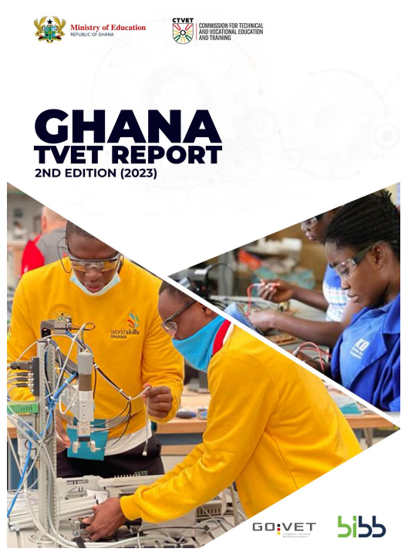

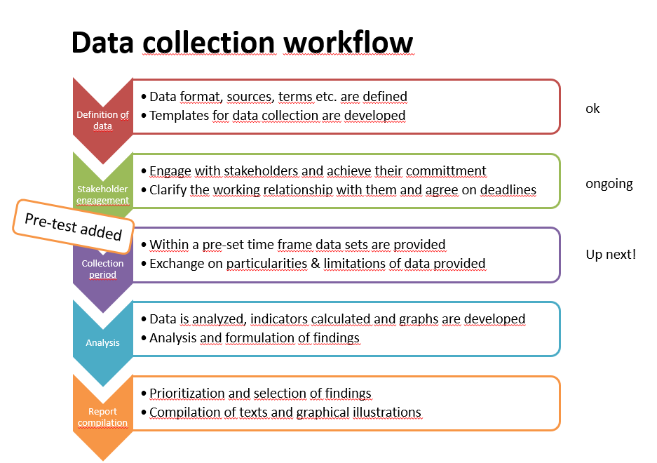
3. Proven practice internationally: Lessons learned from Ghana
Cooperation between the Commission for TVET (CTVET) and GOVET in place since 2019
Two reports published
to date:
2021 and 2023
GOVET advises
CTVET on
data reporting
and monitoring
Project phases
Definition
of objectives
Definition of
content structure
and indicators
Involvement
of interest
groups
Data
collection
Creation
of author
teams
Compiling
of report
Internal and
external
checks
Validation workshop
Publication of the
report

Slide 25

3. Proven practice internationally: Lessons learned from Ghana
Success factors
Create capacity for team members at CTVET
Diverse teams of authors from different departments
Joint project planning
Before publication: Checking and
validation workshop with interest groups
Data collection and conducting data analyses, both internally
Challenges
Availability and quality of data
IT system infrastructure, hosting, administration and maintenance
Financing

Slide 26
3. Proven practice internationally: Lessons learned from Vietnam
BIBB, GIZ and NIVT (Vietnam – National Institute for Vocational Training) have been working together on VET reporting since 2011
Close collaboration between researchers, particularly on the following aspects:
  Quality assurance of Report on Vocational Education and Training
  Coordination
  Cooperation with interest groups
  Feedback on individual chapters
  Knowledge management
  Presentation of data
Range of publications relating to BIBB cooperation
Notes:
NIVT (Vietnam – National Institute for Vocational Training)

Slide 27

3. Proven practice internationally
Further information on both examples
Ghana
2021 report
Published August 2022
Ghana TVET Report 2021
Vietnam
Most recent report:
Viet Nam vocational education
and training report 2021
List of reports in the BIBB website:
BIBB/NIVT-Vietnam
Guideline for sustainable development of VET reporting
in Vietnam
Guideline for sustainable development of TVET reporting in Viet Nam (bibb.de)
Ghana
2022 and 2023 reports
Published in April 2024
Ghana TVET Report 2023

Slide 28
4. Success factors in the VET reporting development process and recommendations
legally binding mandate and defined roles and responsibilities
stable funding
definition of clear indicators and reference dates
regular data analysis and long-term statistics
diverse teams of authors from the institution and beyond
validation using external experts
agreement on scientific standards for data management, analysis and research

Slide 29

4. Success factors in the VET reporting development process and recommendations
Prerequisites
Result
What data is (regularly) available?
Are there data gaps?
How can data gaps be closed (in the future)?
List of indicators for a vocational training report
The goal
Benefits
What needs to be measured?
Which situations need to be described (on a regular basis)?
Provides basis for further development of VET system.
“SMART”
Indicators correspond clearly to the desired theoretical objective, are measurable and can be applied to the desired working context, are relevant to the solution concerned and are understandable for all participants.
Group reporting to
S Specific
M Measurable
A Achievable
R Relevant
T Time bound
Who is the target group for the report? (public)
This can influence the data processing.

Slide 30
5. Further references and materials
English version of the German Vocational Training Report (2021)
bibb.de/dienst/publikationen/de/19715
BIBB website on VET research
Federal Institute for Vocational Education and Training (BIBB) – Germany
Short summary of the cooperation with Vietnam for the purpose of preparing a vocational training report
BWP 6/2014 (bibb.de)
Project report from BIBB cooperation with the Philippines
Federal Institute for Vocational Education and Training (BIBB) – Germany
In German: Guideline for the sustainable development of VET reporting in Vietnam
BIBB/VET reporting in Vietnam –
a reflection on the advisory process
UNESCO indicators for vocational education and training
ces.uis.unesco.org

Slide 31
GOVET at BIBB

