Slide 1
日期、地点、主讲人
德国的双元制职业教育

Slide 2
内容
德国的双元制职业教育
  基础与框架
  动机、利益与流程
  成功模式
Notes:
1.>>> Examination boards with equal representation, jointly agreed training standards, joint management of the system at all levels
2.>>> Around 70 % in the company
3.>>> Vocational training standards, certificate issued by the chamber
4.>>>In and from the companies, state teachers at the vocational schools
5.>>> Data reports, vocational training report, training standards (BIBB)

Slide 3
双元制职业教育:
基础与条件

Slide 4

基础
德国教育体系中的双元制职业教育一览
劳动力市场
职业教育
全日制
职业学校
双元制
职业教育
高校教育
普通学校教育

Slide 5

基础
参与者: 待培训对象 (学徒 Azubis)
  每年有122万学徒
  进入327个国家承认的须培训职业
这意味着:
  目前5%的从业人员是学徒
其中约91%的人可以成功毕业。
Notes:
Supplementary information:
> Overall, approximately 53 % of the population have started a dual vocational training programme in their lifetime
> The employment rate is high: Approximately 96 % of all graduates find a job (compared to 82% without a vocational qualification)
The positive effect:
> Youth unemployment in Germany is only around 5 %

Slide 6

基础
参与者: 雇主
  每年约有19%的负有缴纳社保义务的正规企业提供培训名额
  (220万家企业中的约41万家)
  每年约49万名新学徒
  其中77%在培训毕业后会被培训单位直接录用
Notes:
Supplementary information:
> Trainees are on average 20.0 years old
> The average investment per trainee per year is 18,000 euros
> 70 % of this (approx. 13,600 euros) is amortised (productive contribution of the trainees)
This means:
> international competitive advantage for German SMEs
> future personnel trained according to own needs
> low investment on the labour market international competitive advantage for German SMEs

Slide 7
基础
经济界、社会合作伙伴和国家负责确保双元制职业教育的框架条件
  工商会
  社会合作伙伴 (雇员和雇主协会)
  国家
工商会和社会合作伙伴: 确定并审核企业的培训内容
国家: 设定法律框架并为职业学校教育提供资源
Notes:
Supplementary information:
> The three stakeholders ensure the framework conditions for vocational education and training through a differentiated distribution of roles
> Ownership lies with all three players; they all bear it at the same time and assume responsibility
> They guarantee the system's constant capacity for innovation
> They ensure quality standards

Slide 8
基础
参与方: 工商会——主管单位
  对提供培训的企业进行审核和登记
  对企业培训过程进行监督和审核
  对培训师进行资格认定
  组织考试
  提供信息和咨询服务
Notes:
The impetus for the development and updating of training standards comes from companies and chambers. They know best which skills are needed.
Other tasks:
> Supporting companies in their search for trainees, registering training contracts
> Mediation in the event of disagreements between trainees and companies
> The economy invests €7.7 billion in vocational training every year

Slide 9

基础
参与方: 社会合作伙伴
工会和雇主协会及国家通过协商谈判确定双元制职业教育中企业培训的标准
  培训内容
  培训工资
  对企业内的培训工作进行监督
  参与考试委员会
Notes:
Supplementary information:
> The process of coordinating and adopting new training regulations is managed by the Federal Institute for Vocational Education and Training.
> Economic and social partners are involved in the entire process.

Slide 10
基础
参与方: 国家 —— 制定大纲
  与社会合作伙伴协商制定培训条例（企业实训）
  定义职业学校的理论学习部分: 教学大纲
  为公立职业学校体系提供资金、组织和运行监督
  开展职业教育研究 (联邦职业教育研究所，简称BIBB)
  为寻找学徒位置提供帮助 (比如青年人、失业者和弱势群体)
Notes:
Detailed information:
> State funding totals around € 6.8 billion, including over € 3 billion for 1,550 vocational schools and around € 2.4 billion for control, monitoring and support measures
> State passes the Vocational Training Act

Slide 11
基础
大纲: 标准
  定义双元制职业教育在企业和职业学校的实施
  保证双元制职业教育的质量控制和资金支持
  这些标准在全德国范围内实施并有法律效力
Notes:
> If necessary, summarise the previous slides again
> Three main stakeholders agree on the basic standards for dual vocational training on an equal footing.
> These standards are based on the specific requirements of the world of work.

Slide 12
基础
大纲: 标准的制定
  1. 雇主 确认企业新出现的工作领域及从业要求
  2. 社会合作伙伴和国家 协商并通过由联邦职业教育研究所提出的新企业
  培训标准
  3. 国家 调整教学大纲，以与新制定的培训条例保持一致
将修改和增加的标准写进培训条例（企业）和教学大纲（职业学校）。
Notes:
Supplementary information:
> The duration of the further development and implementation of standards is max. 1 year
> Standards are dynamically adapted to the requirements of the world of work at both learning venues
> BIBB continuously researches changes in work and training; the findings are incorporated into the process

Slide 13
基础
大纲: 标准 —— 培训条例
企业实训标准由培训条例确定：
  职业名称
  职业特性
  培训内容
  时间范围和时间划分
  考试要求
Notes:
Job profile >>>
Which competences must be taught?
Contents >>>
Which specific skills and tasks must be mastered?
Examination knowledge >>>
What knowledge optimally prepares trainees for their final examination?

Slide 14
基础
大纲: 标准 – 教学大纲
职业学校在双元制职业教育中承担从事这些职业所需的专业理论知识及综合基础课教学。
其标准规定在教学大纲中，包括:
  学习目标
  学习内容
  学习领域
Notes:
The contents of the framework curriculum are defined by ‘learning fields’.
If necessary, explain the topic of ‘learning fields’ at this point.

Slide 15
基础
法律框架
根据《基本法》第12条，人人均享有择业自由。
企业法规
教育法规
职业教育法
青少年劳动保护法
手工业条例
劳资协定法
工商会暂行规制法
企业组织法
义务教育法
地区性学校教育法规
Notes:
Explain the dynamics of the vocational training system using BBiG amendments, most recently in 2020: principle of equivalence of vocational and academic education codified

Slide 16
双元制职业教育:
动机、利益与流程

Slide 17

参与
动机与措施 —— 国家
动机: 为了确保经济增长和发展，德国需要高水平专业人才。
共识: 我们必须强化和引导双元制职业教育体系的发展。
措施:
  确定法律框架并不断更新
  确定更多的参与方
  不断对整个体系进行审查和拓展
  (主要通过联邦职业教育研究所)
Notes:
Further motivation:
> Vocational training secures the social status of young people as citizens
> The state cannot guarantee vocational training alone: costs and competences
Further measures:
> Ensuring permeability: university access for trainees with a degree
> Opening up dual vocational training regardless of previous qualifications

Slide 18
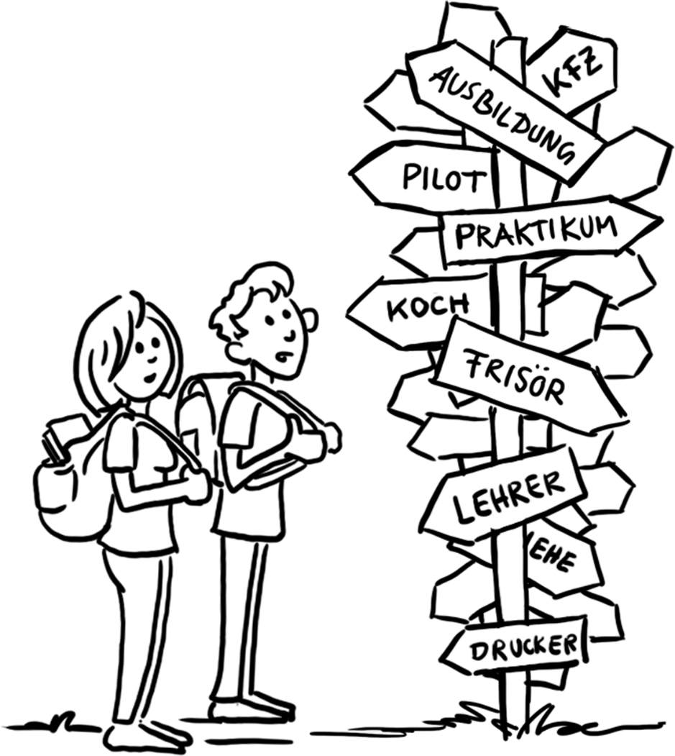
参与
动机和参与 —— 青年人
动机: “我想成为……！”
参与:
  寻找可能的企业并考虑企业给出的条件
  写申请书
  必要时参加甄选流程
  选择培训企业
  签署培训合同
Notes:
Young people have many different expectations and goals when it comes to an apprenticeship:
> learn something practical
> earn their own money (self-employment)
> realise a dream
> social prestige
> fulfilment of duties

Slide 19

参与
动机和参与 —— 企业
动机: “我想确保每个职位都有人来做。”
参与:
  获准成为培训单位
  提供培训名额
  评估申请书
  挑选学徒
  签署培训合同
Notes:
There are a few other reasons here too:
> We are looking for loyal employees
> We know best which qualifications are needed in our company
> We want to act in a socially responsible manner
> We seek the input and innovative potential of young people
> We save on familiarisation and retraining costs

Slide 20

流程
培训合同
在雇主与学徒签署培训合同后，双元制职业教育正式开始。
培训合同对以下内容进行规定:
  培训时长
  培训内容
  试用期
  内容及时间分配
  工资
  双方的权力和义务
Notes:
The training contract also regulates
> holiday entitlement
> any requirements for termination of the training contract
The training contract is similar to an employment contract. It is the basis for learning in the company during training.
The training contract is registered by the chambers.

Slide 21

流程
在两个培训地点进行双元制学习
70%的培训在企业进行
30 % 的时间在职业学校上课
在真实的工作条件下接受系统化培训
学徒要参与进具体的企业工作过程中
学徒有工资
以班级的形式上课
职业相关内容占2/3
一般通识课程占1/3
双元制职业教育时间为两年到三年半。
Notes:
Legal basis:
... for in-company training > Training contract
... for the vocational school > Compulsory schooling
Time allocation:
for example:
Monday to Wednesday: in the company
Thursday and Friday: at the vocational school
Alternatively: block teaching
Additional information:
> In-company training and vocational school lessons follow the training standards

Slide 22
流程
毕业考试
毕业考试
  由工商会组织
  分为理论考试和实操考试
  考试委员会的构成为
    雇主
    雇员 (工会代表)
    职业学校教师 (代表国家)
Notes:
Important:
No involvement of the respective teaching and training staff!

Slide 23
流程
毕业考试
毕业证书
  由工商会出具
  受国家承认
通过毕业考试后培训结束。
职业生涯开始。

Slide 24

流程
职业生涯开始: 机会
劳动力市场
  直接与培训单位签署工作合同
  与其他企业签署工作合同
  在其他职业领域就职
继续深造
  培训及进修课程
  上大学 (“符合入学条件”)
Notes:
As a reminder:
> Around 96% of all graduates in Germany find a job after completing their training.
> Around 74% of all trainees are taken on by the company that trained them.

Slide 25
双元制职业教育:
成功模式

Slide 26
双元制职业教育是如何运作的?
总结
流程
  培训在企业 (70 %)和职业学校 (30 %)平行开展: 此谓“双元”
  培训有法定的内容和时长 (培训合同)
  培训在具体的工作流程中开展
  由独立委员会组织毕业考试

Slide 27
双元制职业教育是如何运作的?
总结
框架
  国家制定法律框架
  国家组织职业学校教育
  工商会和社会合作伙伴确定培训的范围和内容
  工商会做为主管单位对企业开展的培训进行监督
Notes:
Reminder:
Chambers are the representatives of the economy, trade unions/employee representatives and associations/employer representatives are the social partners.
They reach a consensus.
Conclusion I:
> Dual vocational training is essentially shaped by those who are directly affected and who know the needs of the labour market best.
Conclusion II:
> All decisions on vocational training are made by consensus.
Conclusion III:
> The standards apply nationwide. They are regularly updated.

Slide 28
为什么德国的双元制教育取得了成功?
成功因素
  本体系在德国有历史底蕴
  社会接受程度高
  学徒和企业双赢
  根据人才需求进行培训
  强有力的机构保障 (工商会, 社会合作伙伴, 中小型企业)
  所有参与方共同完成系统设计
  体系有着高度的灵活性和适应性
Notes:
Demand for skilled labour:
> Germany is a developed industrialised nation with a strong SME sector.
Win-win situation:
> Apprentices learn on the job and are integrated into the work process. Companies train their own future workforce according to their own needs
Qualified training staff:
> Trainers are ‘from the trade’ and have undergone training themselves and also know the company
Supplementary information:
> Although the state controls the process as a legislator and sets the framework, it leaves key decisions to the direct stakeholders.

Slide 29
双元制职业教育的五大支柱
支柱
  国家、经济界和社会合作伙伴之间的合作
  在工作流程中学习
  制定普遍承认的国家标准
  高水平的职业培训师队伍
  专门的研究和咨询机构
Notes:
Examination boards with equal representation, jointly agreed training standards, joint management of the system at all levels
Around 70 % in the company
3. Vocational training standards, certificate issued by the chamber
4. In and from the companies, state teachers at the vocational schools
5. Data reports, vocational training report, training standards (BIBB)

Slide 30
获益
学徒方的获益:
双元制职业教育是正式参加工作前理想的预备阶段:
  可获取本职业所需的专业能力和资格
  可体验真实的工作条件 (机器, 工作流程, 工作环境)
  有培训工资
Notes:
Further advantages:
> Greater identification with the training company
> Training as a basis for further measures

Slide 31
获益
企业方的获益:
双元制职业教育可确保企业获得高水平的员工:
  可获得满足企业需求的高素质专业人才（与外部录用人员相比）
  提高生产力 (员工可迅速上手工作)
  主动参与培训标准的开发
  为企业社会责任 (CSR)做出贡献
Notes:
Another advantage:
> Recruitment and retraining costs are reduced

Slide 32
获益
国家和社会的获益:
互利互惠，高生活水平和社会稳定:
  高经济效益和生产力
  和谐的劳动力市场(供/需关系)
  让年轻人融入经济与社会
  所有参与方都对教育过程有影响力
Notes:
Another advantage:
> Early indicator for developments in the economy and labour market

Slide 33
挑战
学徒方面对的挑战
  想找的和企业提供的培训职位不一定一致
  (职位不足)
  进入双元制职业教育的门槛
  职业要求在不断提高
  终身学习
Notes:
Discrepancy:
> 2018: almost 80,000 applicants without a training place
Access:
> Lack of informal skills: Discipline, reliability, basic skills (reading, writing, maths)
Requirements:
> For example: IT skills, foreign language skills
Lifelong learning:
> Especially for older applicants

Slide 34
挑战
企业方面对的挑战
  提供的培训职位与学徒理想职位之间的差异
  (申请人不足)
  如何设置“参与培训的资格”
  残障人士的融入
  移民的融入
Notes:
Discrepancy:
Unfilled training places 2010: 19,800 / 2018: 57,700 - almost tripled
‘Maturity for training’:
Lack of social skills, basic knowledge
Inclusion:
High extra personnel and time expenditure, special qualifications of the training staff

Slide 35
挑战
国家与社会面对的挑战
  人口结构变化
  可预见的专业劳动力匮乏
  接受高等学历教育的趋势
  地区差异
  融入度
Notes:
Demographic change
Fewer young people able to go into training, labour market needs can no longer be met
Trend towards academisation
Training tends to be out, university is in
Regional differences:
Supply and demand for training places
Inclusion:
as a social task

Slide 36
其他信息
数据与事实
  BIBB Datenreport 联邦职教所数据报告(link)
  Statistisches Bundesamt 联邦统计局(link)
  BMBF Datenportal联邦教育部 (link)
  Berufsbildungsbericht职业教育报导 (link)
培训标准
  BIBB Broschüre: Ausbildungsordnungen und wie sie entstehen 联邦职教所宣传册(link)
  Beispiele für die Ausbildungsordnungen und Rahmenlehrpläne (BIBB)职教条例与教学大纲举例 (link)
法律文件
  Berufsbildungsgesetz 联邦职业教育法(link)
  Jugendbeschäftigungsgesetz青年从业法 (link)
  Kammergesetz协会法 (link)
  Tarifverhandlungsgesetz薪酬等级谈判法 (link)
  Betriebsverfassungsgesetz企业组织法 (link)
  网址
  GOVET
  BMBF
  BIBB

Slide 37
GOVET at BIBB

