Slide 1
Vocational education and training in Germany
Institutionalised VET research

Slide 2
Contents
  Features of vocational education and
  training research
  Why VET research?
  Statutory general conditions
  VET research stakeholders in Germany
  International comparative VET research
  VET research at BIBB
  VET research at BIBB – example projects
  Further examples of institutional VET research
  Cooperation and networking in VET research
  Use of research findings
  Summary

Slide 3
1. Features of vocational education and training research
Comparatively young field of research
Legally established within the Vocational Training Act (Berufsbildungsgesetz, BBiG)
Heterogeneous research area:
  Interdisciplinary nature
  Integration of different academic disciplines
    Educational science
    Sociology
    Economics
    Labour market research
Topics selected in line with needs of business,
VET practice and VET policy
Application focus (education practice, policy and governance)
Focus on a range of target groups:
  Pupils
  Trainees
  Vocational education and training staff
  Vocational schools
  Companies
  Policymakers
Cooperation and networking: cooperation between
research institutions, educational institutions and industry, international cooperation
Results are publicly available
Notes:
“Young” field of research:
Institutionalised VET research began with the founding of DATSCH (Deutsche Ausschuss für technische Schulung [German Committee on Technical Education] established in 1908 by associations in the metal and electrical processing industry) and DINTA (Deutsches Institut für technische Arbeitsschulung [German Institute for Technical Training] established in 1925 by the association of iron founders) (Dobischat, R. & Düsseldorff, K. (2017)). Berufliche Bildung und Berufsbildungsforschung [Vocational education and training and VET research])
Institute for Employment Research (IAB) established in 1969
Federal Institute for Vocational Education and Training Research (BBF) established in 1970.

Slide 4

2. Why VET research?
Relevance to education system
Economic relevance
Quality [and attractiveness] of vocational education and training
Social participation
Competitiveness
Skilled workers etc.
Policymakers, business and social partners require information on developments in vocational education and training, the education system and the labour market to be able to respond to challenges and regulate the VET in an evidence-based way. Research and development are mutually dependent in this respect.
Globalisation
Technological development
International perspective
Skilled worker migration,
recognition etc.
Artificial intelligence
Media landscapes etc.
Changes in society
Changes in the world of work
Demographic trends
Migration etc.
Need for new occupational profiles
Flexibilisation of work etc.
Notes:
Economic relevance:
Contributes to competitiveness of the economy
Ensures availability of skilled workers for the labour market
Societal relevance:
Promotes social mobility
Contributes to social integration
Attractiveness of vocational education and training
Globalisation:
Monitors developments in international vocational education and training
Learning from other countries and VET systems
Recognition of foreign qualifications
Technological development:
Impacts of new technical opportunities (e.g. AI) on vocational education and training, work and qualification requirements
Lifelong learning and continuing professional education
Updating training regulations for training occupations on the basis of technological progress (e.g.: revision of tax clerk training regulation/ r 2023 due to implementation of electronic procedures)
Changes in society:
Ageing population and its impact on the labour market
Successful integration of migrants in the VET system and the labour market
Changes in the world of work:
Emergence of new occupational profiles and the need to adapt existing training occupations (e.g. introduction of new immersive media designer training occupation in 2023)
Flexibilisation of working conditions and its implications for VET
Demand for “Green Skills” / “Green Jobs”

Slide 5



3. Statutory general conditions
The Vocational Training Act (BBiG) forms the legal basis
BBiG, (2020)*, Section 84: Objectives of vocational education and training research:
  “Vocational education and training research must...
  … clarify the fundamentals of vocational education and training,
  … track domestic, European and international developments in vocational training,
  … identify standards for the contents and objectives of vocational education and training,
  … pave the way for further developments in the field of vocational education and training to meet changed economic, societal and technical requirements,
  … further the development of instruments and procedures for the provision of vocational training and promote the transfer of knowledge and technology.”
* Vocational Training Act as published in the official notification of 4 May 2020 (BGBl I p. 920), last amended by Article 2 of the law of 19 July 2024 (BGBI. 2024 I p. 246).

Slide 6
4. VET research stakeholders in Germany
Research institutes
(private and public)
Federal state institutes
(esp. development of teaching and school-based staff training at vocational schools)
Institutes of higher education and universities
Associations and foundations
Examples:
Federal Institute for Vocational Education and Training (BIBB)
Institute for Employment Research at the Federal Employment Agency (IAB)
Research Institute for Vocational Education and Training (f-bb)
Institute for In-company Training (IFBB)
Institute for Educational Quality Improvement (IQB)
Examples:
State institute for school quality and education research (ISB)
Lower Saxony federal state institute for school quality improvement (NLQ)
Hamburg federal state institute for teacher training and school development (LI-Hamburg)
Saxony-Anhalt federal state institute for school quality and teacher training (LISA)
Bremen federal state Institute for schools (LIS)
Examples:
Research Institute for Vocational Edu-cation and Training in the Crafts Sector
Department of Vocational Education Studies at Osnabrück University
FernUniversität in Hagen (state distance-learning university) Institute of Educational Science and Media Research,
Chair of Lifelong Learning
Institute of Vocational Education, Work and Technology (biat) at Europa-Universität Flensburg
Examples:
Division for Vocational Education at the German Educational Research Association (GERA)
Robert Bosch Stiftung
Bertelsmann Stiftung
GAB München – Association for Research & Development in Vocational Training and Occupations
The various stakeholders often work together in and on research projects
Notes:
The Institute for Educational Quality Improvement (IQB) is an associated institute of Humboldt-Universität zu Berlin and was established in 2004. The central task of the IQB is the development, operationalisation, standardisation and review of training standards. It is a research institute supporting the German federal states which are members of the “Institute for Educational Quality Improvement – academic institution of the federal states at Humboldt-Universität zu Berlin e. V.”
BIBB has a series of project-related cooperative arrangements in place with institutes of higher education and universities. Project-independent cooperative arrangements have also been established with various institutes of higher education and research institutions:
University of Wuppertal
Münster University of Applied Sciences
FernUniversität in Hagen
Friedrich-Alexander-Universität Erlangen-Nürnberg (FAU)
Friedrich Schiller University Jena
Helmut Schmidt University Hamburg
Bonn-Rhein-Sieg University of Applied Sciences
Hochschule Bremen City University of Applied Sciences
Institute for Employment Research (IAB), Nuremberg
Otto von Guericke University of Magdeburg
University of Bonn
Technical University of Darmstadt
Technical University of Kaiserslautern
Bielefeld University
Duisburg-Essen University
University of Flensburg
University of Cologne
Paderborn University
University of Münster

Slide 7
5. International comparative VET research
The aim of comparative vocational education and training research is to describe, understand and explain the features and principles of vocational education and training in different national and cultural contexts.
Examples:
UNESCO-UNEVOC
CEDEFOP
International Handbook of Vocational Education and Training (IHBB)
“TVET Country profiles” provide extensive information on VET worldwide. This includes, for example
VET policy objectives
Vocational education and training system
Financing
Role of training personnel
Individual projects of respective countries
European Center for the Development of Vocational Training (CEDEFOP) “VET in Europe” database: current and easily accessible information on the respective national VET systems in Europe
detailed national reports, skills forecasts, academic analyses and recommendations on trends and development requirements in European vocational education and training
Academic country studies on global VET systems, available since 1995
BIBB has been publishing the IHBB since 2010 and making country studies available in the BIBB VET Repository since 2020

Slide 8
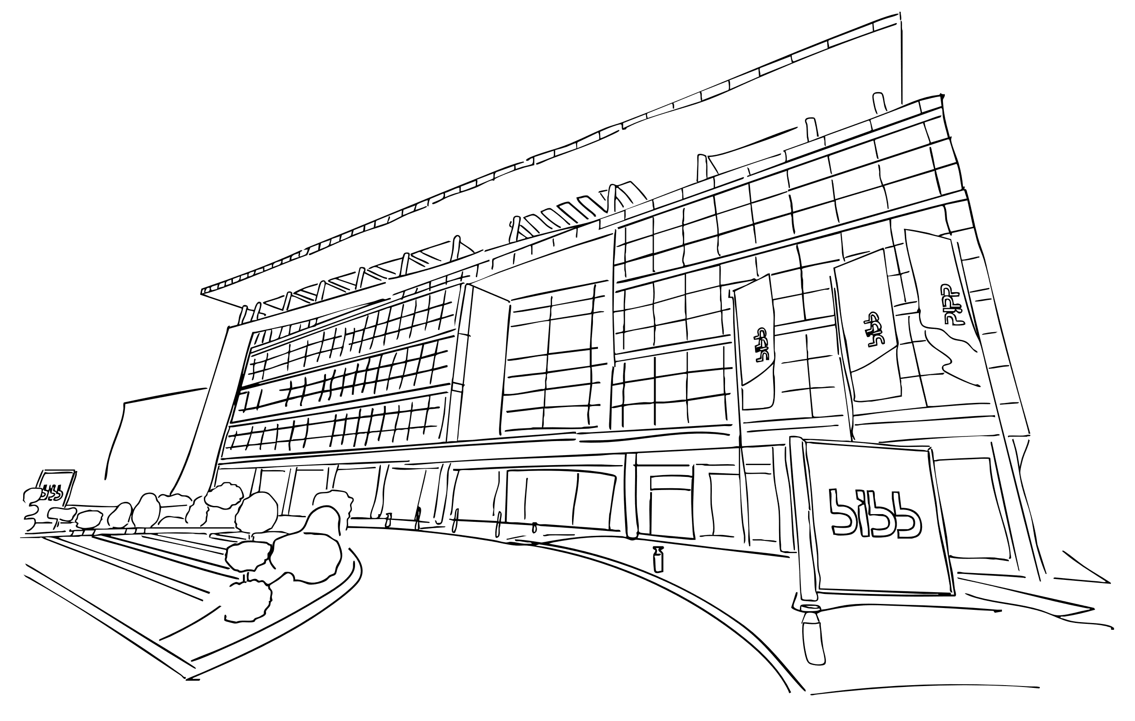
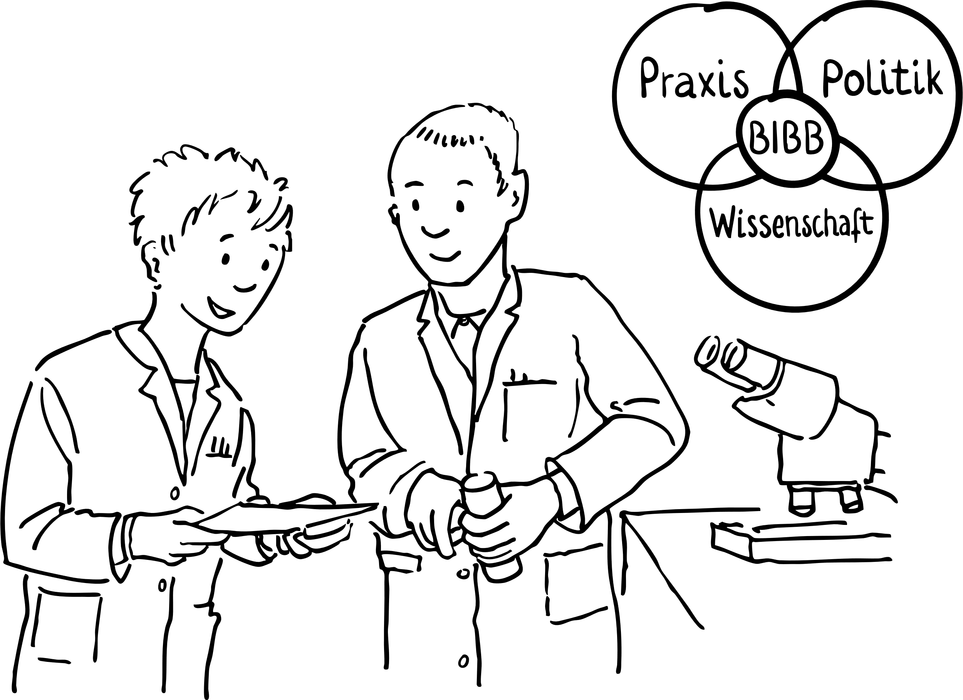
6. VET research at BIBB
Section 90 of the Vocational Training Act assigns the Federal Institute for Vocational Education and Training (BIBB) with the task of contributing to vocational training research by means of scientific research.
VET research is characterised by discourse at the interface between science, politics and practice and ...
... its purpose is to further academic understanding
... is focused on questions which are interest to vocational education and training practice and policymaking
... creates the basis for the modernisation of occupations and for innovation
in vocational education and training
Notes:
From the BIBB mission:
We play an active role in the scientific system with our vocational education and training research. Our research is focused on key questions in vocational
education and training and contributes to theory development. It is interdisciplinary and bound by academic standards. We cooperate with institutes of higher education and research institutions, we support young academic research talent and provide academia with access to our research data.

Slide 9

6. VET research at BIBB
The basis of VET research conducted by BIBB comprises medium-term research programmes with a duration of several years as well as annual research programmes.
Current topic clusters (2019–2025):
digital transformations – future of vocational education and training and work
company decisions and actions – factors influencing company training and recruitment
work-based learning – conditions, diagnostics and support
vocational orientation and transitions – integration into training and work
occupational segmentation in training – characteristics and functionalities
regulation-related structuring and governance of vocational education and training

Slide 10
6. VET research at BIBB
BIBB’s vocational education and training research work is conducted in the form of projects.*
There is a distinction between:
  Research projects financed from BIBB’s core budget – the institution’s “own research” (in accordance with Section 90(2), sentence 2 BBiG) and
  Research projects implemented on the basis of instructions and contracts (in accordance with Section 90(2) sentence 3 BBiG) and by attracting external funding outside of the federal administration (in accordance with Section 90(4) BBiG)
A distinction is also made between development projects and academic research services.
The development of the institute’s own research programmes takes place within the scope of a concentrated discussion process, in which the BIBB committees are involved (= different VET stakeholders in Germany)
* Source: 2024 Annual research programme of the Federal Institute for Vocational Education and Training. 2024.
Notes:
Research projects are either self-financed or externally funded as commissioned and third-party research.
Development projects aim to create a product (such as training regulations) or a service.
Academic research services support transfer and may be accessed by external users (e.g. data portals, publications).

Slide 11
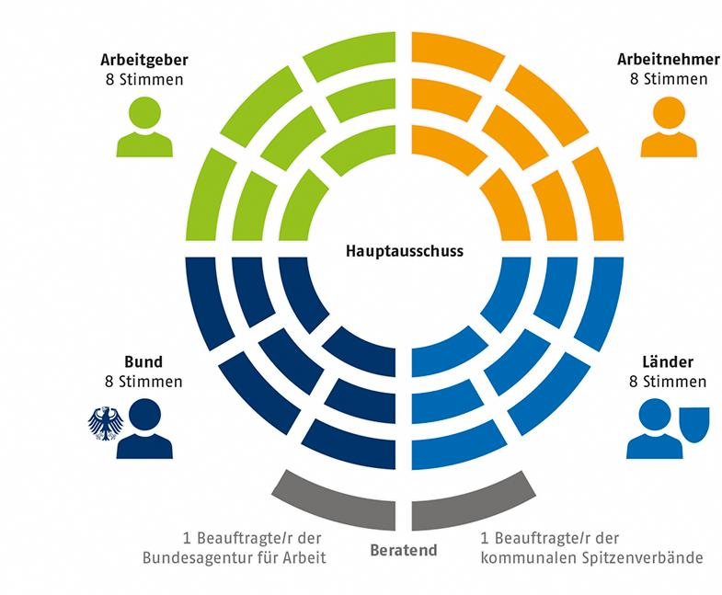
6. VET research at BIBB
BIBB committees involved in research planning
Employers
8 votes
Employees
8 votes
Board:
adopts the medium-term research programmes and annual research programmes
BIBB Board
two sub-committees for vocational training research at BIBB and for the annual consultations on the draft of vocational training report
State
8 votes
Federal states
8 votes
1 Representative of the Federal Employment Agency
consultative
1 Representative of the Representative of the municipal umbrella organizations
Source: BIBB: https://www.bibb.de/en/463.php
Notes:
Extract from the Vocational Training Act (BBiG)
Section 92: Board
(1) In addition to the tasks assigned to it under other provisions of this Act, the Board has the following further tasks:
it determines the affairs of the Federal Institute for Vocational Education and Training insofar as these have not been assigned to the President;
it advises the Federal Government on basic issues relating to vocational education and training and may submit an opinion on the draft Report on Vocational Education and Training;
it determines the annual research programme;
it may make recommendations concerning the uniform application of this Act;
it may state its views on the draft statutory instruments prepared by the Federal Institute for Vocational Education and Training in accordance with section 4 (1), taking into account the corresponding draft framework curricula for school-based training;
it determines the affairs of the Federal Institute for Vocational Education and Training mentioned in section 90 (3) nos. 3 and 4, and in section 97 (4).
(2) The President informs the Board without delay of instructions to implement tasks in accordance with section 90 (3) no. 1, and administrative provisions issued in accordance with section 90 (3) no. 2.
(3) The Board consists of eight representatives each of the employers, the employees and the Länder (Federal states) as well as five representatives of the Federal government. The representatives of the Federal government hold eight votes, which can only be cast uniformly; they have no right to vote on matters concerning advice to the Federal Government on basic issues relating to vocational education and training, on the opinion concerning the draft Report on Vocational Education and Training, and within the framework of consultations under this Act. One representative each of the Federal Employment Agency, the umbrella organisations of municipal associations established at federal level and the Research Council may attend the meetings of the Board in an advisory capacity.
(4) The employers’ representatives are appointed on the proposal of the organisations of the chambers, employers’ associations and industrial associations established at federal level, the employees’ representatives on the proposal of the trade unions organised at federal level, the federal representatives on the proposal of the Federal Government, and the representatives of the Länder on the proposal of the Bundesrat; they are appointed by the Federal Ministry of Education and Research for a period not exceeding four years.
(5) The Board elects for the period of one year one member to serve as chair and another member to serve as deputy chair. The chair is proposed in turn by the representatives of the employers, the employees, the Länder and the Federation.
(6) The members of the Board serve in an honorary capacity. Insofar as they receive no compensation from any other source, they are to be paid appropriate compensation for out-of-pocket expenses and for loss of earnings at a rate to be specified by the Federal Institute for Vocational Education and Training with the approval of the Federal Ministry of Education and Research. Such approval is granted in agreement with the Federal Ministry of Finance.
(7) Members may be removed from the Board for an important reason after consultation with the parties involved in their appointment.
(8) The representatives have substitutes. Subsections (4), (6) and (7) apply accordingly.
(9) The Board may, according to the provisions of the statutes, appoint subcommittees which may include as their members persons other than members of the Board. As a rule, the membership of the subcommittees must include representatives of the employers, the employees, the Länder and the Federation. Subsections (4) to (7) apply to subcommittees accordingly.
(10) The Board is not bound by any instructions in the execution of its tasks.

Slide 12
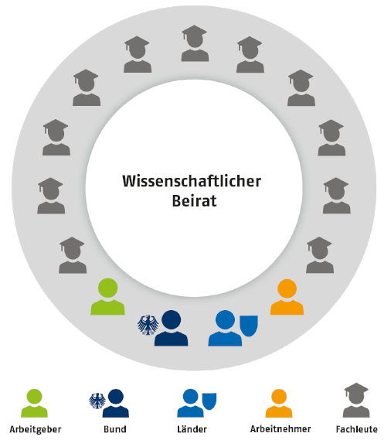
6. VET research at BIBB
BIBB committees involved in research planning
Research Council:
advises both of BIBB’s executive bodies – the Board and the president – by means of written opinions on and recommendations for BIBB's research work
Research Council
evaluates the scientific quality of research projects and the scientific sustainability of the research programmes
consists of eleven recognized specialists in the area of vocational training research from Germany and abroad
Employers
Government
Federal States
Employees
Experts
Source: BIBB: https://www.bibb.de/en/463.php
Notes:
Extract from the Vocational Training Act (BBiG)
Section 94 Research Council
(1) The Research Council advises the organs of the Federal Institute for Vocational Education and Training by means of opinions and recommendations in respect of
the research programme of the Federal Institute for Vocational Education and Training,
the cooperation of the Institute with higher education institutions and other research institutions; and
the annual reports on the results of research by the Federal Institute for Vocational Education and Training.
(2) The Council receives all the information required for the execution of its tasks from the President of the Federal Institute for Vocational Education and Training. Upon request, the Council is given explanatory information on the research work of the Federal Institute for Vocational Education and Training once a year within the framework of colloquiums.
(3) The Council consists of up to eleven recognised specialists in the area of vocational training research from Germany and abroad who are not staff of the Federal Institute for Vocational Education and Training. They are appointed by the President of the Federal Institute for Vocational Education and Training in agreement with the Federal Ministry of Education and Research for a period of four years. One successive reappointment is possible. Four members of the Board, namely one representative each of the employers, the employees, the Länder and the Federation, may participate in the meetings of the Research Council without voting rights.
(4) The Research Council may adopt its own rules of procedure.
(5) Section 92 (6) applies accordingly.

Slide 13
6. VET research at BIBB
Surveys and statistics*
Vocational education and training research at BIBB uses a wide range of qualitative and quantitative research methods. These include regular empirical surveys.
BIBB surveys
Training allowances (link)
BIBB establishment panel on training and competence development (link)
BIBB survey of newly concluded training contracts as of 30.09. (link)
BIBB surveys on the costs and benefits of continuing professional education for individuals (link)
BIBB Expert Monitor (link)
BIBB surveys of the costs and benefits of company-based vocational education and training (link)
BIBB Nursing Panel (link)
BIBB School Leaver Surveys (link)
BIBB Transition Studies, 2006 and 2011 (link)
Reference company system (RBS) (link)
*Some of the sources are only available in German.
Notes:
Training allowances
The Federal Institute for Vocational Education and Training has been monitoring the development of training allowances based on collective agreements for more than 40 years. To support this, the “Database of training allowances based on collective agreements” was developed. This enables the current average levels of allowances based on collective agreements to be identified annually (reference date 1 October) for a large number of quantitatively significant training occupations .
BIBB establishment panel on training and competence development
The Federal Institute for Vocational Education and Training's establishment panel on training and competence development is a representative annual survey of at least 3,500 companies in Germany. The survey has been conducted every year since 2011. The main focus is the examination of structures, developments, general conditions and contexts of company-based training activity.
BIBB survey of newly concluded training contracts as of 30.09.
The BIBB survey of newly concluded training contracts as of 30.9 is conducted annually in collaboration with the competent bodies responsible for vocational education and training. This takes into account newly concluded training contracts entered into in the period from 1 October of the previous year to 30 September of the survey year which are still in existence as of 30.09.
BIBB surveys on the costs and benefits of continuing professional education for individuals
BIBB examines the costs incurred by individuals for continuing professional education and training and the benefits they anticipate or gain from this. Knowledge of these aspects helps to explain participation patterns and to describe how the cost burden is spread.
BIBB Expert Monitor
The BIBB Vocational Education and Training Expert Monitor was developed as an online survey instrument in 2004. Up until 2018 its purpose was to facilitate the systematic questioning of experts on current educational policy issues. The Expert Monitor was stopped in 2019.
BIBB surveys of the costs and benefits of company-based vocational education and training
Since the 1980s, BIBB has been surveying training companies on the costs and benefits of their training. This is based on the cost model developed in 1974 by the Expert Commission on the Costs and Financing of Vocational Training. Overall, six surveys have been conducted for the years 1980, 1991, 2000, 2007 and the training years of 2012/13 and 2017/18. The seventh survey is being conducted with companies through to mid-2024 and will provide data for the 2022/23 training year.
BIBB Nursing Panel
The Federal Institute for Vocational Education and Training carries out monitoring of vocational and university-based nursing training. The BIBB Nursing Panel forms the basis of this. Training institutions, nursing colleges and institutes of higher education are surveyed on a regular basis. This means BIBB is fulfilling its statutory mandate in accordance with Section 60 (6) of the Training and Examination Regulations for the Nursing Professions (PflAPrV)
BIBB School Leaver Surveys
In the years 2004, 2005, 2006, 2008, 2010 and 2012, school leavers were surveyed on their career interests and on how they chose an occupation. The surveys were conducted by Forsa, Berlin, on behalf of the Federal Institute for Vocational Education and Training.
BIBB Transition Study 2006 and 2011
In order to obtain further information on the educational backgrounds and career pathways of young people and young adults following general education school, the BIBB conducted two studies in 2006 and 2011.
Reference company system (RBS)
The reference company system is currently being used to survey around 1,200 companies once or twice a year on current issues in company-based vocational education and training and, since 2010, also on the current business situation. The key findings from these surveys are summarised in the RBS information.

Slide 14

6. VET research at BIBB
Surveys and statistics*
BIBB surveys in cooperation with partners:
Adult Education Survey (AES) (link)
Recognition Monitoring (link)
BA/BIBB applicant surveys (link)
BIBB/BAuA Labour Force Survey (link)
Continuing Vocational Training Survey (CVTS) (link)
Continuing Training Monitor (link)
Official statistics
The Vocational Education and Training Statistics of the Federal Statistical Office and the Statistical Offices of the Federal States (survey 31.12): Trainee data (link)
iABE – Integrated VET reporting (link)
*Some of the sources are only available in German.
Notes:
Adult Education Survey (AES)
The European adult education survey AES is a survey of participation and non-participation of adults in life-long learning.
Recognition monitoring
How many people seek advice on recognition? Does advice automatically lead to an application? In how many cases is full or partial equivalence determined? These and other questions are investigated by the process of recognition monitoring.
BA/BIBB Applicant Surveys
The BA/BIBB Applicant Survey is a representative, extrapolated written-postal random sample survey of young people who were registered as training place applicants with the Vocational Guidance Service of the Federal Employment Agency.
BIBB/BAuA Labour Force Surveys
Changes in work and occupations, acquisition and utilisation of vocational competencies
Continuing Vocational Training Survey (CVTS)
The CVTS surveys gather data on the following topics: form, content and scope of continuing vocational training, company expenditure on continuing vocational training, training policy and CVT strategies of companies, as well as factors that inhibit or promote company-based continuing vocational training.
wbmonitor
The Continuing Training Monitor (wbmonitor) is the largest annual survey of continuing education and training providers in Germany. wbmonitor is a cooperative project conducted by the Federal Institute for Vocational Education and Training (BIBB) in conjunction with the German Institute for Adult Education – Leibniz Centre for Lifelong Learning (DIE).
The Vocational Education and Training Statistics of the Federal Statistical Office and the Statistical Offices of the Federal States (survey 31.12): Trainee data
In the “Trainee data system” (DAZUBI), the Federal Institute for Vocational Education and Training (BIBB) processes trainee, contract and examination data from dual vocational education and training in accordance with the Vocational Training Act (BBiG) and the Crafts and Trades Regulation Code (HwO).
iABE – Integrated VET reporting
The Integrated VET reporting (iABE) documents the training establishments and programmes which young people attend following lower secondary level. Various official statistics are linked together ("integrated") for this purpose. Training activity is focused on the following four sectors: vocational education and training, transitional sector, attainment of higher education entrance qualification and degree.

Slide 15

6. VET research at BIBB
Fostering young talent
The fostering of young academic research talent is a strategic objective of vocational education and
training research at BIBB.
BIBB has a range of different programmes in place to support this:
Graduate support
Young talent groups
Dissertation projects (in cooperation with universities)
Training programme
Information for students
Notes:
Graduate support
BIBB funds three young talent groups, each has a post-doctoral researcher and two PhD positions. A further 16 PhD positions are also funded and assigned to the major research projects and divisions. The graduate support programme connects PhD students with each other and facilitates discussion of dissertation projects and the PhD experience.
https://www.bibb.de/de/128201.php
Young talent groups
Opportunity for young post-doctoral academic research talent to develop their own broad-based research programme. The young talent group manager is responsible for the content and design of the research project and for two PhD candidates who research the project topics. Candidates must complete an extensive assessment and selection process.
https://www.bibb.de/de/128197.php
Dissertation project
Doctoral researchers come from a range of different specialist fields and are integrated into the different divisions, research projects and young talent groups. In each case they examine separate issues while being actively integrated within wider research and project contexts.
https://www.bibb.de/de/132431.php
Training programme
In order to fully support PhD students during their doctorate and to prepare them for professional life, a training programme provides them with the relevant skills and competencies for a career in research and in research intensive sectors.
https://www.bibb.de/de/128195.php
Information for students
Offer of placement positions, dissertation support, tips on research and data use
https://www.bibb.de/de/128193.php

Slide 16

6. VET research at BIBB
BIBB Data Report to accompany the federal government’s Report on Vocational Education and Training
Key information sources and data basis for the federal government’s Report on Vocational Education
and Training submitted by the Federal Ministry of Education and Research (BMBF)
Annual information and analysis on initial and continuing vocational education and training since 2009
Provides an overview of federal government and federal state programmes for supporting
vocational education and training and provides information on international indicators and
benchmarks
The report includes differentiated presentations of indicators and time series, focuses on thematic
priorities and summarizes key information on the different topic areas of initial and continuing
vocational education and training.
In order to prepare the report, primary research is conducted (e.g. BIBB survey of newly concluded training contracts as of 30 September, BIBB school leaver survey, BA/BIBB applicant survey, PROSIMA – econometric forecast and simulation model of the training system) and research contracts for special analyses are awarded to external institutions.
Notes:
The first Report on Vocational Education and Training was published in 1977. Up until 2008, BIBB provided “information and data on vocational education and training” in part two of the Report on Vocational Education and Training
BIBB published the Data Report to accompany the Report on Vocational Education and Training for the first time in the 2009 Report on Vocational Education and Training.
Examples from the BIBB Data Report
The following examples are documented annually: Supply-demand ratio of training places, list of recognised training occupations under Vocational Training Act (BBIG)/Crafts and Trades Regulation Code (HwO), company participation in training
Special focus topics: e.g.:
“Vocational education and training in the socio ecological transformation” (2024);
“Innovation in vocational education and training through programmes” (2023);
“Ensuring provision of skilled workers and qualified migration: exploiting potential” (2022)

Slide 17

7. VET research at BIBB – project examples
Accompanying research for ASCOT+ (Technology-based Assessment of Skills and Competences in VET)
Time period 2019–2023
BMBF funded
Aim: develop digital learning and measurement instruments for the competencies of trainees and trial these in practice
Coordination office was BIBB
Transfer findings from ASCOT+ into research and practice (e.g. into teaching and learning processes and into regulatory work)
Technical, scientific and administrative support for funded projects
Public relations
Transfer of knowledge was a central common theme in ASCOT+ and was considered in project design.
The result is a wide range of digital measurement instruments, teaching and learning offers and training materials which can be used by interested parties under a free licence.
Notes:
A complete listing of BIBB projects is available here:
DaPro – Project database of the Federal Institute for Vocational Education and Training (https://www.bibb.de/dienst/dapro/en/index_dapro.php)

Slide 18

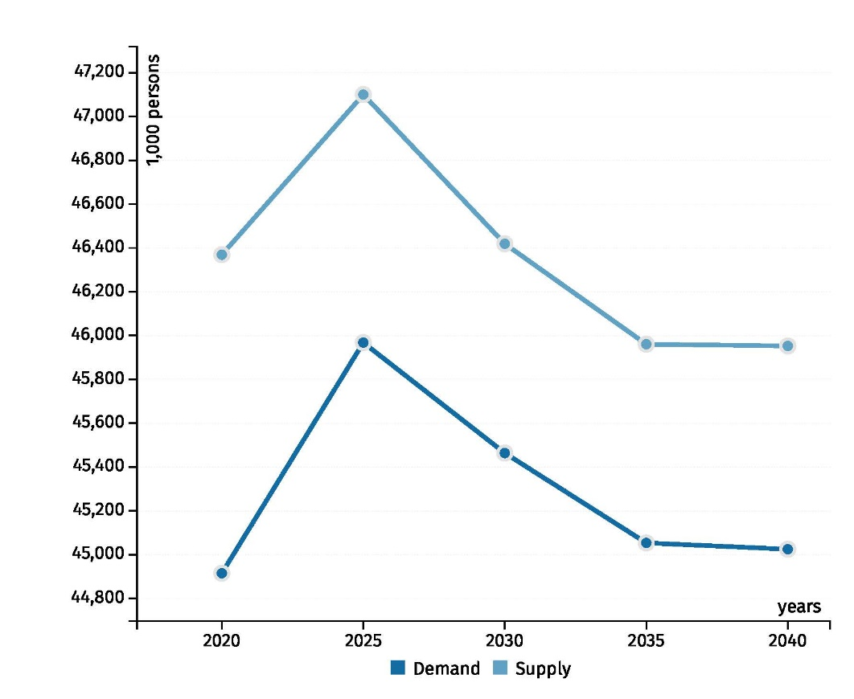
7. VET research at BIBB – project examples
QuBe project – qualifications and occupations in the future
run under joint leadership of the Federal Institute for Vocational Education and Training (BIBB) and the Institute for Employment (IAB) in collaboration with the Institute of Economic Structures Research (GWS).
a long-term overview of the likely development of labour demand and supply in terms of qualifications and occupations to the year 2040
differentiated by 141 occupational groups
projection results can be selected, presented and downloaded by different occupational groups, qualifications, requirement levels, persons and work volume.
Time series – Persons
Notes:
To the QuBe data portal:
https://www.bibb.de/en/qube_datenportal.php#/

Slide 19
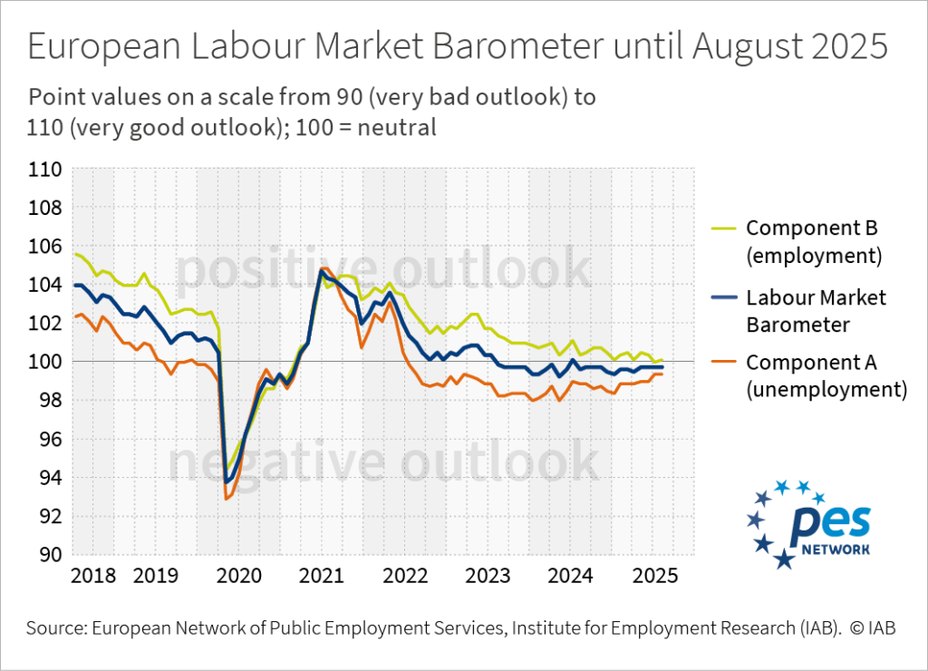
8. Further examples of institutional VET research
German Institute for Adult Education (DIE)
Research into continuing education and lifelong learning
Projects for improving continuing education systems and offers
Institute for Employment Research (IAB):
Research Institution of the Federal Employment Agency (BA)
Labour market research focused on vocational education and training
Example: IAB Labour Market Barometer, studies on labour market integration of graduates, and relationships between training processes and labour market opportunities
BA as well as quantitative and qualitative surveys form the empirical basis

Slide 20
8. Further examples of institutional VET research
Research Institute for Vocational Education and Training (f-bb):
Implementation of design and transfer projects for vocational education and training
Preparation of case studies
Empirical surveys, and evaluations,
Scientific support for funding programmes and pilot projects.
Examples of current studies:
Study on the inward and outward migration of EU citizens
Study “Constantly changing demands – how companies and employees are preparing for the future, together”
Piloting an evaluation of “Trialling working worlds of the future” at the Ministry for Infrastructure and Digital Affairs
Future of digital participation for people with disabilities – opportunities, risks and potential solutions (digitaleTeilhaBe)

Slide 21


9. Cooperation and networking in VET research
Cooperation between the different research stakeholders increases the potential of vocational education and training research
Creation of synergies and interdisciplinary discourse
Different disciplines consider the research topic from different perspectives, asking different questions and using different methodological approaches
Financing from a range of sources can be used for research projects
International cooperation in vocational education and training research generates
new perspectives, research questions, development work and consultancy
BMBF funding initiative for the internationalisation of vocational education and
training from 2017
BIBB cooperates with numerous international partner institutions.
Notes:
BMBF funding initiative “Förderung der Internationalisierung der Berufsbildung” [Funding Internationalisation of Vocational Education and Training]
“German academic expertise in the area of vocational education and training research and the training of vocational education and training staff should be made accessible to foreign partners and assist them in the reform of their national systems. The establishment of an interdisciplinary and transdisciplinary research network to support international VET cooperation should be promoted in an overarching manner. For this purpose, a supporting measure should be provided for in addition to this official notification” *BMBF notification 25.09.2017–31.03.2018 Guideline for funding research into the internationalisation of vocational education and training. Federal Official Gazette of 25.09.2017; https://www.bmbf.de/bmbf/shareddocs/bekanntmachungen/de/2017/09/1417_bekanntmachung.html)
BIBB partner institutions:
AACC / USA - American Association of Community Colleges
CEDEFOP - European Centre for the Development of Vocational Training
CEREQ / France - Centre d'Études et de Recherches sur les Qualifications
CINOP / Netherlands - Center for Innovation in Education
CIVTE / China - Central Institute for Vocational and Technical Education
CONALEP / Mexico - Colegio Nacional de Educación Profesional Técnica
CPI / Slovenia - The Centre for Vocational Education and Training of the Republic of Slovenia
CTVET / Ghana - Commission for Technical and Vocational Education and Training
SFUVET / Switzerland - Swiss Federal university for Vocational Education and Training
FICCI / India - Federation of Indian Chambers of Commerce and Industry
FIRO / Russia - Federal Institute of Educational Development
IAL / Singapore - Institute for Adult Learning
ibw / Austria - Institute for Training Research in Trade and Industry
INAPP / Italy - Istituto Nazionale per l’Analisi delle Politiche Pubbliche
IVET NAPS / Ukraine - Institute of Vocational Education and Training of the National Academy of Pedagogical Science
KRIVET / Korea - Korea Research Institute for Vocational Education and Training
MINEDUC / Chile - Chilean Ministry of Education
NAPOO / Bulgaria - National Agency for Vocational Education and Training
NCE / Latvia - National Centre for Education
NCTVETD / Romania - National Centre for Vocational Education and Training Development
NCVER / Australia - National Centre for Vocational Education Research
NIVT / Vietnam - National Institute for Vocational Training
NSZFI / Hungary - Nemzeti Szakképzési és Felnöttképzési Intézet
NÚV / Czech Republic - National Institute for Education
öibf / Austria - Austrian Institute for Research on Vocational Training
OVEC / Thailand - Office of the Vocational Education Commission
ROA / Netherlands - Research Centre for Education and the Labour Market
SENA / Colombia - National Service for Vocational Education
SENAI / Brazil - National Service for Industrial Training
SIOV / Slovakia - State Institute for Vocational Education of the Republic of Slovakia
TESDA / Philippines - Technical Education and Skills Development Authority
UNESCO-UNEVOC - United Nations' International Centre for Technical and Vocational Education and Training

Slide 22

9. Cooperation and networking in VET research
The Federal Working Group on Vocational Education Research (AGBFN) is a voluntary association of scientific institutions:
BIBB
Division for Vocational Education of the German Educational Research Association
Institute for Employment Research
(IAB)
The educational institutes of the
federal states
Publicly and privately funded research institutes

Slide 23
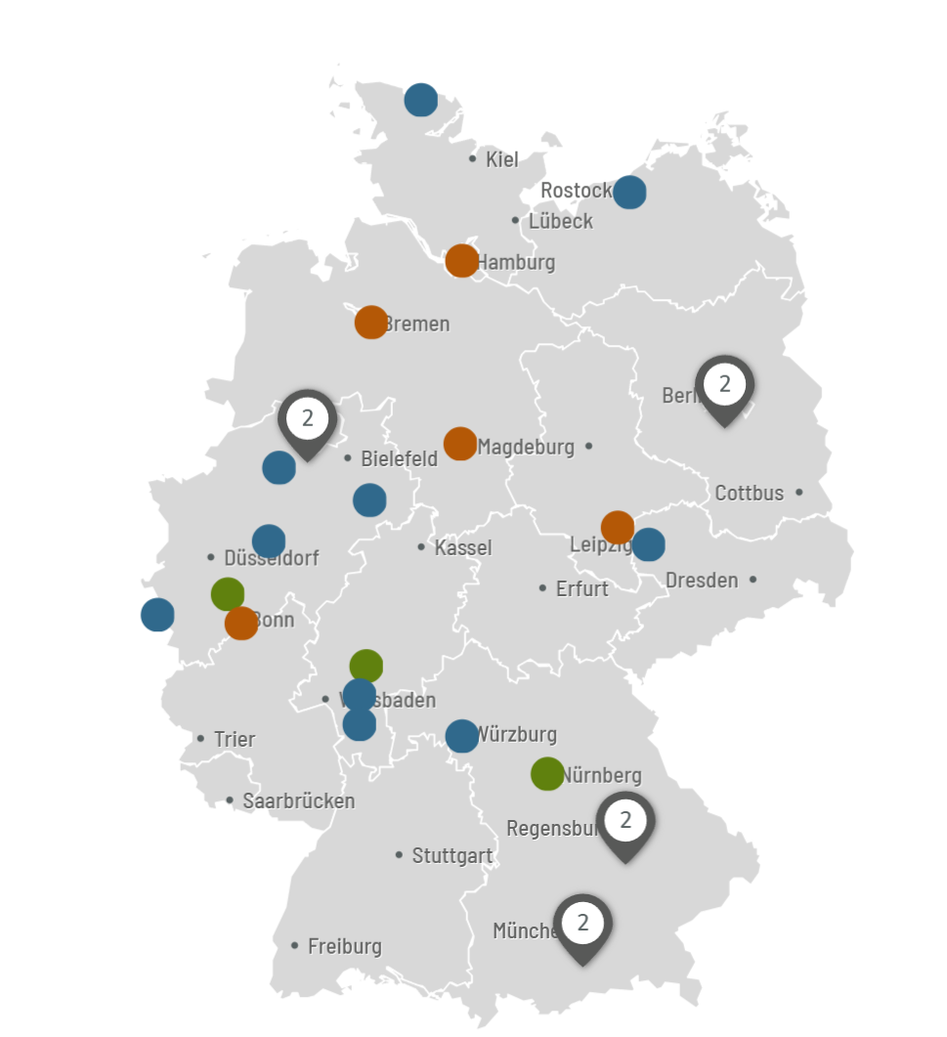
9. Cooperation and networking in VET research
AGBFN – Partners include:
BIBB:
State Institute for school quality and education research (ISB) Munich
Technical University of Darmstadt, Institute of General and Vocational Education, area of study of Vocational Education
Research Institute for Vocational Education and Training (f-bb) Nuremberg
Hamburg federal state institute for teacher training and school development (LI-Hamburg)
Lower Saxony state Institute for Quality Development in Schools (NLQ)
GEBIFO – Society for the Promotion of Educational Research and Qualification mbH Berlin
cevet – Centre for vocational education and training (Paderborn)
University of Rostock, Institute for Vocational Education
Saxony-Anhalt federal state institute for school quality and teacher training (LISA)
Bremen federal state Institute for schools (LIS)
RWTH Aachen University, Academic and Research Department Technical Didactics of Structural Engineering
German Economic Institute, Research Unit Vocational Education and Professionals
Goethe University Frankfurt, Faculty 02 Economics and Business, Chair of Business Ethics and Business Education
Training Institute of the Hesse Economy – Research unit (BWHW)
University of Würzburg – Chair of Special Education V
Institute of Vocational Education, Work and Technology (biat) at Europa-Universität Flensburg
University of Osnabrück – Institute for Health Research and Education, Department of Didactics of Human Service Professions
FernUniversität in Hagen – Institute of Educational Science and Media Research,
Chair of Lifelong Learning
Scientific Network for Career Guidance (WiN BO)
GAB München – Association for Research & Development in Vocational Training and Occupations
Institut für Innovation und Technik [Institute for Innovation and Technology] in VDI/VDE Innovation + Technik GmbH
Verein für sozialwissenschaftliche Beratung und Forschung e. V. [Social Science Consultancy and Research Association]
Institute of Social Science Consultancy (ISOB GmbH)
Osnabrück University – Department of Vocational Education Studies
Leipzig University – Institut für Wirtschaftspädagogik [Institute of Business Education]
Notes:
Key for map:
Orange: Federal government/federal states
Blue: Institutes of higher education
Green: Institutes of independent and public sector providers
Further information: https://www.agbfn.de/de/index.php

Slide 24
9. Cooperation and networking in VET research
Arbeitsgemeinschaft Berufliche Bildung (AG BB) [Vocational education and training working group]
has been organising the “Hochschultage Berufliche Bildung” university conference on vocational training every two years since the 1980s – conference venue alternates between universities
The aim of the university conference is to promote discourse between research, policymakers and practice
BIBB is a founding member of the AG BB and is active on its Board.
Centre for Vocational Education and Training (CeVet)
at Paderborn University
International centre of excellence for research and for professionalisation in addressing the challenges relating to all aspects of vocational education and training
Involvement of stakeholders with different perspectives of the problem in question.
Network comprising national and international partners from companies, education and training policymaking, training institutions and other institutes
Main areas of research include career orientation, professionalisation and support for vocational education and training practice
Notes:
BIBB has a series of project-related cooperative arrangements in place with institutes of higher education and universities. Project-independent cooperative arrangements have also been established with various institutes of higher education and research institutions:
University of Wuppertal
Münster University of Applied Sciences
FernUniversität in Hagen
Friedrich-Alexander-Universität Erlangen-Nürnberg (FAU)
Friedrich Schiller University Jena
Helmut Schmidt University Hamburg
Bonn-Rhein-Sieg University of Applied Sciences
Hochschule Bremen City University of Applied Sciences
Institute for Employment Research (IAB), Nuremberg
Otto von Guericke University of Magdeburg
University of Bonn
Technical University of Darmstadt
Technical University of Kaiserslautern
Bielefeld University
Duisburg-Essen University
University of Flensburg
University of Cologne
Paderborn University
University of Münster

Slide 25

10. Use of research findings
Results of vocational education and training research should be freely available:
enables scientific discourse
increases the transparency and clarity of research results
facilitates broad-based and rapid dissemination as well as visibility
A freely available description of research approaches and methodology means that research projects are easier to understand, adapt and replicate in other countries/training systems
Example: www.bibb.de/en
Example: BIBB specialist journal
“Vocational Training in Research and Practice” (BWP)
Databases
Research Data Centre metadata portal
Database of training allowances based on collective agreements
Specialist publications, free of charge
VET Repository
BIBB Data Report to accompany the Report on VET
BIBB adopted an Open Access policy in 2011 in order to support the dissemination of vocational education and training research results free of charge in accordance with the Open Access principle.
Published four times a year. Academic findings and practical experience of current issues in vocational education and training are published here Each issues has a thematic focus,
e.g.:
Labour market and vocational education and training (BWP 3/2024)
Migration and integration (BWP 2/2024)
Artificial intelligence (BWP 1/2024)
Notes:
Open Access at BIBB:
BIBB has set itself the goal of supporting the dissemination of vocational education and training research results free of charge and without barriers – in line with the Open Access principle. For this reason, BIBB formally adopted an Open Access Policy in March 2011. On 1 May 2014, it also signed up to the Berlin Declaration on Open Access to Knowledge in the Sciences and Humanities. BIBB also supports the Open Access 2020 Initiative launched by the Max Planck Society which wants to see the majority of the academic research journals published today switching to an Open Access publication policy. In May 2020, BIBB also signed the mission statement of the ENABLE! community. The aim of ENABLE! is to further the Open-Access transformation in the humanities and social sciences in a way which is community-based and discipline-oriented.
As part of the implementation of its Open Access Policy, all BIBB specialist publications have been made directly accessible in accordance with the Open Access principle under the CC licence CC BY-SA 4.0.
(https://www.bibb.de/en/35836.php)

Slide 26
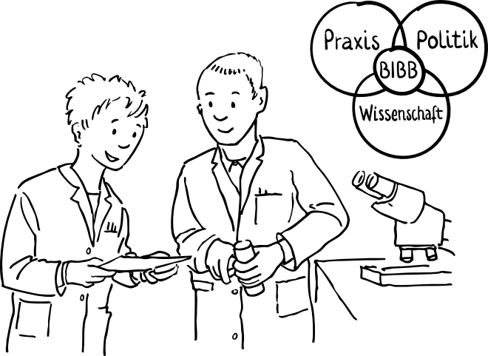
11. Summary
Research results
Stakeholders
are publicly available
are used in the dialogue between government, business and social partners
help when making the choice of initial and continuing VET measures in the transition into the employment system
justify training planning decisions and help to prepare these
The variety of stakeholders in vocational education and training research contributes to the quality of research and helps with the ongoing modernisation of VET and with making it competitive.
Synergy effects resulting from partnerships, exchange and joint projects
Government
facilitates institutionalised vocational education and training research by providing a statutory framework, funding and by awarding contracts

Slide 27
Further information
This presentation, further presentations and information on German vocational education and training and international VET cooperation are all available on our website at:
www.govet.international/en
Sources*
BIBB/VET research (link)
BIBB Data Report (link)
KMK (link)
BMFTR Data Portal (link)
Destatis statistics on VET (link)
Institute for Employment Research (link)
Research Institute for Vocational Education and Training (f-bb) (link)
Further information on the Internet
AGBFN (Vocational Education and Training Research Network) (link)
CeVet (link)
BIBB VET Repository (link)
BIBB specialist publications (link)
BIBB Research Data Centre (link)
BIBB specialist journal BWP (Vocational Training in Research and Practice) (link)
*Some of the sources are only available in German.

Slide 28
GOVET at BIBB

