Slide 1
Inter-company vocational training centres
VET in
Germany

Slide 2

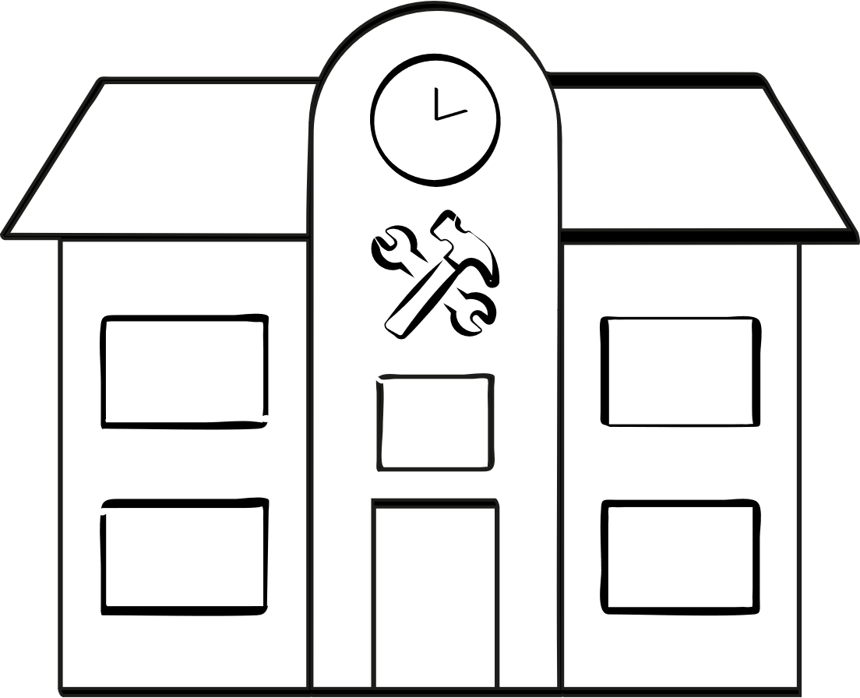
1. Framework data
Approx. 1,100 inter-company vocational training centres across Germany
Mainly concentrated in the craft trades
High-end technical equipment
Providers:
Chambers (chambers of crafts and trades, chambers of commerce and industry, chambers of agriculture)
Guilds, district craft trade associations, professional associations
Non-profit legal entities under German public law
Qualified training staff (master craftsmen, technicians, engineers)
Important component of German education and training infrastructure
Notes:
Legal entities under German public law: frequently spin-offs of the public bodies or professional associations mentioned above, usually non-profit, e.g. bearing the suffix gGmbH (not-for-profit limited company) or e. V. (registered association) etc., non-profit status is a prerequisite for state funding.

Slide 3

2. Tasks of inter-company vocational training centres
Diverse range of vocational training provision
Inter-company training within the scope of dual vocational education and training
Venue for the conducting of dual vocational education and training examinations
Continuing training measures:
Upgrading training programmes, e.g. leading to master craftsperson, technician or
Bachelor Professional qualifications
Certifications, e.g. in welding
Various seminars leading or not leading to a certificate
Employment agency measures, e.g.:
Retraining programmes
Training support measures
Vocational preparation schemes
Notes:
Legal entities under German public law: frequently spin-offs of the public bodies or professional associations mentioned above, usually non-profit, e.g. bearing the suffix gGmbH (not-for-profit limited company) or e. V. (registered association) etc., non-profit status is a prerequisite for state funding.

Slide 4
2. Tasks of inter-company vocational training centres
Core areas of inter-company vocational training centres
Vocational orientation
Internship placements
Centres of excellence in the area of innovation, education and training and technology
International projects
Technical consultancy services for
small and medium-sized companies
Involvement in pilot projects in the
area of innovation, education and training and technology
Meeting points, networking venues

Slide 5

3. Objectives of inter-company vocational training centres
Ensuring that small and medium-sized enterprises (SMEs) are able to provide training
Quality assurance in vocational education and training
Ensuring a uniform training standard by fully covering all required
training contents
Supporting the competitiveness of SMEs
Technology transfer

Slide 6



4. Financing of inter-company vocational training centres
Basic principle
Costs are the responsibility of the providers.
Total of about
€5 billion
in state funding since 1970
(on the basis of the Vocational Training Act, BBiG, of 1969)
Aim
Basic provision nationwide from a quality assurance perspective
Proportionate investments
Phased subsidies for ongoing costs
(inter-company training/inter-company
apprentice instruction, support for the SME sector)
Grants from the Federal Government, federal states and the EU

Slide 7
5. Financial support for inter-company vocational training centres
Stakeholders and resources
Funding of inter-company vocational training centres
by
BIBB:
(Federal Institute for Vocational Education and Training)
Funding from the Ministry of Education
and
BAFA
(Federal Office for Economic Affairs and Export Control)
Funding from the Ministry of Economic Affairs
Investment volume reported
approx €2.3 billion
Total investment volume (applications submitted)
around €951 million
Programmes:
  Equipment, modernisation, restructuring, lead and follow-up projects
  Integration of new technologies into training
  Digitalisation
  Further development into centres of excellence

Slide 8
5. Financial support for inter-company vocational training centres
Development of funding of inter-company vocational training centres 1970 to the present
1970–1979
  Basic funding
  New buildings, initial equipment, basic infrastructure, support
  for craft trades
1980–1989
  Funding for expansion and modernisation
  Modernisation of equipment, integration of new training
  occupations, staff training
1990–1999
  Funding for structural adjustment
  Adjustment to new training regulations, cooperation arrangements with federal states and chambers, specialised inter-company vocational training centres
2000–2006
  Technical modernisation
  CNC, CAD/CAM technology, IT equipment, teaching materials
2007–2015
  Preparation for digitalisation
Integration of digital teaching methods, pilot projects, media skills
2016–2019
  Digitalisation (phase 1)
Digital tools, VR/AR, network formation, training for trainers
2020–2025
  Digitalisation and sustainability
Industry 4.0, sustainability, energy efficiency, modular learning provision, hybrid forms of learning

Slide 9
6. Upgrading of inter-company vocational training centres into centres of excellence
Specialisation
Modern equipment
Innovation
  Centres of excellence are specialised inter-company vocational training centres which pool expert knowledge in certain sectors, occupations or technologies.
  They have particularly high-end and innovative technical equipment in place which often exceeds the standards of normal vocational training centres, e.g. in areas such as CNC, 3D printing, smart home, e-mobility etc.
  Centres of excellence address technological developments such as digitalisation, sustain-ability and new manufacturing procedures and teach these in a practically related manner. They create new courses and concepts which are then adopted by other inter-company vocational training centres.
National significance
Technology transfer
  The aim is that they should exert an impact nationwide and, for example, serve as a contact point for training for whole sectors rather than merely working for their own respective region.
  Centres of excellence transfer new tech-niques and practices which have emerged from research and development into operational practice. They advise companies on issues relating to training, the deploy-ment of technology and modernisation.

Slide 10


7. Inter-company vocational training centres and technology transfer
The craft trade organisations set up consultancy, information and technology transfer points and provide professional and neutral advice to companies in the sector.
The Federal Ministry for Economic Affairs and Energy (BMWE) funds the following modules for this purpose:
Company Advisors
Advisory Centres for Innovation and Technology
Specialist Advisory and Information Points
All three modules draw on the potential (know-how, technical equipment) of
inter-company vocational training centres.
Within this context, inter-company vocational training centres serve as innovation hubs which network the stakeholders. They provide the advisors with the necessary specialist background and establish contacts with the target group.
Example: “CraftLab” based on the Schwerin model – creating spaces for innovation

Slide 11


8. Inter-company training
Company
Vocational school
Inter-company
vocational training
centre
Approx. 1,100 in number

Slide 12

8. Inter-company training
Overview
Inter-company vocational education and training (also referred to as inter-company apprentice instruction) takes place at inter-company vocational training centres which are operated by chambers of
crafts and trades, by guilds or by other training providers.
Objectives
Consolidation and systematisation of basic vocational training
The costs of the inter-company vocational training centres are usually borne by the companies pro-viding training, which receive support in the form of subsidies paid by the Federal Government, the federal states and other funding bodies.
Supplementing and ensuring a uniformly high standard by balancing out internal company specialisation
Participation in these courses is compulsory for trainees in the craft trades, and companies providing training are required by law to release their trainees.
Adjustment of vocational skills to current techno-logical development

Slide 13


8. Inter-company training
Legal basis
§ 5 (2) No. 6 of the Vocational Training Act (BBiG): “The training regulation may allow for elements of the vocational education and training to be completed in suitable establishments outside the training centres if and insofar as the vocational education and training necessitates this (inter-company vocational education and training).”
§ 21 Paragraph 2 of the Crafts and Trades Regulation Code (HwO): “A training venue at which the necessary occupational skills, knowledge and competencies cannot be imparted to their full extent
is deemed as suitable if such skills, knowledge and competencies are imparted via training measures outside the training venue.”
Inter-company vocational training centres form parts of the company-based training time.
Inter-company vocational education and training/inter-company apprentice instruction is not normally explicitly mentioned in the training regulations. The decision regarding the implementation and scope of inter-company training in an occupation is a cooperative process in which various institutions take part.

Slide 14

8. Inter-company training in the craft trades
Summary
Inter-company vocational education and training/inter-company apprentice instruction is an important building block of the dual system of VET in Germany.
It ensures consistently high quality of training in every occupation in the craft trades, irrespective
of the capacity of the individual craft trades company to provide training.
Decisions regarding inter-company vocational education and training/inter-company apprentice instruction are made within the scope of self-administration in the craft trades sector.
The contents and duration of inter-company training is jointly stipulated by the umbrella professional associations and by the Heinz Piest Institute of Skilled Trades at the Leibniz University of Hanover.
Recognition takes place via the Federal Ministry for Economic Affairs and Energy (BMWE) or via the federal state ministries responsible.
The nationally standardised course provision currently encompasses around 500 curricula for inter-company instruction, which are available for a majority of the craft trade occupations.

Slide 15
8. Inter-company training in the skilled crafts
Chambers of crafts and trades
Stakeholders
Heinz Piest Institute (HPI)
  Are the lead organisation for the execution and co-ordination of inter-company vocational education and training/inter-company apprentice instruction. They decide on the contents, duration and organi-sation of the courses together with specialist com-mittees. They often operate their own training centres or commission other providers.
  The HPI operates in close collaboration with the umbrella professional associations to develop the nationally standardised inter-company vocational education and training/ inter-company apprentice instruction curricula, including contents, durations
  and cost calculations for the basic and specialist level. These plans form the foundation for funding applications to the BMWE and the federal states.
Guilds and professional associations
Social partners
  Incorporate sector-specific requirements into the planning and provide feedback on the contents and quality of the inter-company vocational education and training/inter-company apprentice instruction.
  In certain sectors, such as the construction industry, the parties to collective wage agreements agree on the number and contents of courses. The ministry respon-sible enacts binding skeleton curricula on the basis of these agreements.

Slide 16
8. Inter-company training in the skilled crafts
Tasks of the HPI
Stake-holders
Heinz Piest Institute
The HPI observes technological developments and, by integrating these into the course concepts, it ensures that contents are practically related in areas such as digitalisation, energy efficiency and electromobility. The inter-company vocational training centres thus serve as a platform to transfer modern technologies into the everyday company routine.
The HPI has been analysing the take-up of inter-company vocational education and training/inter-company apprentice instruction on behalf of the BMWE and the German Confederation of Skilled Crafts (ZDH) for over 40 years. It examines aspects such as number of participations, intensity and funding rate and also identifies trends. This data forms the basis for policy decisions and funding strategies.
In its capacity as a research institute at the Leibniz University of Hanover, the HPI is inte-grated into applied research. It supports small and medium-sized craft trade companies with technological issues and initiates innovations which are then adopted into training.

Slide 17

8. Inter-company training in the skilled crafts
Example 1: Motor vehicle craft trades sector (1/3)
Exists for the following occupations:
Motor vehicle mechatronics technician
Motor vehicle body and vehicle construction mechanic
Passenger motor vehicle technology
Vehicle varnisher
(with craft trade training)
Commercial motor vehicle technology
Motor cycle technology
System and high-voltage technology
For all: participation mandatory

Slide 18
8. Inter-company training in the skilled crafts
Example 1: Motor vehicle craft trades sector (2/3)
Nationally standardised inter-company vocational education and training/inter-company apprentice instruction skeleton curricula
Modular structure
Basic level
1st year of
training
Specialist level 1
2nd year of training
Specialist level 2
3rd year of training
Specialist level 3
4th year of training
The precise modules may vary somewhat depending on the chamber of crafts and trades or training centre.
Average: approx. 4–8 weeks per year of training
Over the entire duration of training (3.5 years in the case of motor vehicle mechatronics technician): mostly a total of 15–20 weeks
Divided across several courses (mostly 1–3 weeks per block)

Slide 19
8. Inter-company training in the skilled crafts
Example 1: Motor vehicle craft trades sector (3/3)
Basic level
1st year of training
Module/course | Contents/main focuses
Health and safety at work & environmental protection | Safety regulations, workshop equipment, recycling
Fundamentals of automotive engineering | Vehicle structure, simple systems, modes of operation
Material processing & joining technology | Filing, drilling, welding, soldering, screwing
Measurement and testing | Handling measuring devices, simple diagnoses
Wheels & tyres | Assembly, balancing, tyre service
Braking technology I | Fundamentals of braking systems, maintenance, simple repairs

Slide 20

8. Inter-company training in the skilled crafts
Example 2: Construction sector (1/3)
High degree of company specialisation,
small company sizes, problems of
attractiveness
The costs of the measures stipulated in the training regulations are covered by
SOKA-BAU, which charges the training centres directly:
Comprehensive collective wage agreement regulation
Training fund at SOKA-BAU (social security funds in the construction industry)
Course fees
Around 180 inter-company vocational training centres are involved in vocational education and training in the construction industry.
Travel costs of trainees
Boarding fees if necessary

Slide 21

8. Inter-company training in the skilled crafts
Example 2: Construction sector (2/3)
Second level: 12 months
Staged training in the construction sector
Specialisation in the chosen training occupation:
 Carpenter
 Stuccoist
 Tile and mosaic layer
 Screed layer
 Thermal and noise insulation fitter  Dry construction builder
 Mason
 Concretor
 Building mechanic
 Furnace and chimney builder  Road builder
 Pipeline fitter
 Duct builder
 Well builder
 Special civil engineering works builder
 Rail track builder
First level: 24 months
Training lasts for 36 months and ends with a journeyman examination.
serves the purpose of basic and specialist vocational training.
concludes with an examination leading to the qualification of building construction worker, construction finishing worker or civil engineering worker.

Slide 22
8. Inter-company training in the skilled crafts
Example 2: Construction sector (3/3)
Year | Company | Vocational school | Training centre | Qualification | Contents/main focuses
1 | 13 weeks | 12 weeks | 14 weeks |  | Basic skills, health and safety at work, materials science, fundamentals in several building trades
2 | 26 weeks | 10 weeks | 8 weeks | Qualification stage 1 Building construction worker/civil engineering worker | More detailed learning, project-related work, initial specialisation, intermediate examination possible
3 | 30 weeks | 10 weeks | 6 weeks | Journeyman examination (e.g. mason, road builder, screed layer etc.) | Specialisation in the trade, complex tasks, customer orientation, preparation for the examination

Slide 23

8. Inter-company training in the area of responsibility of the chambers of commerce and industry
Inter-company training is unusual in many occupations for which the chambers of commerce and industry are responsible (e.g. commercial occupations). In other occupations, especially technical, it is voluntary. There is an indirect obligation in circumstances where training contents cannot be otherwise covered.
Inter-company VET/inter-company apprentice instruction receives support regionally from the inter-company training centres of the chambers of commerce and industry organisation.
Further provision is offered alongside inter-company VET/inter-company apprentice instruction, such as special courses on individual topics or examination preparation courses.
Duration of the courses varies between a few days (e.g. courses in “conventional milling” and “conventional turning”) and several months
(e.g. “Basic Course in Electrical Engineering”, “Basic Course in Mechatronics").
Costs are paid by the company providing training

Slide 24
9. Digression: Cooperative training
An alternative to inter-company training
Cooperative training is an alternative to inter-company vocational education and training/inter-company apprentice instruction if companies providing training are unable to cover the training contents in an occupation in full.
Cooperative training is a form of vocational training in which more than one partner – mostly one or more than one company or educational establishments – collaborate in order to ensure together that full training takes place in accordance with the training regulations.
Four classical organisational types of cooperative training:
Training at one lead company in conjunction with a partner company
Commissioned training
Training consortium
Training with a training association

Slide 25
9. Digression: Cooperative training
The four organisational types in detail
Training at one lead company in conjunction with a partner company
Commissioned training
Training consortium
Training with a training association
One lead company takes charge of the majority of training. It concludes the training contract with the trainee, pays the training allowance and assumes overall responsibility.
Partner companies impart supplementary contents.
A company sends its trainees to a training provider or to another company providing training for a section of training. It pays for this training service.
Companies in the consortium ("ring training”) provide training at the same time and on equal terms.
Each company is always a host and transferring company at the same time.
Trainees only conclude a training contract with their respective main company, which pays the training allowance even when training is taking place at a partner company.
The contractual partner of the trainees is generally a training association. The companies are responsible for the content part of the training.
These companies are association members.
Cooperation agreements are concluded for the areas of responsibility.

Slide 26

10. Inter-company training in international VET cooperation
Overview
Inter-company training has been integrated into in international VET cooperation for decades.
Use of know-how and infrastructure
Training of foreign multipliers in Germany
Deployment abroad of experts from inter-company vocational training centres
Within the scope of development cooperation
Market-based offer for foreign countries (inter-company training = part of the education and training sector engaged abroad)

Slide 27
10. Inter-company training in international VET cooperation
Characteristics
Role model function: In countries with VET systems that tend to be more school-based and theoretical in nature, and where there is little involvement from trade and industry, vocational training centres with training workshops are one way of integrating practical elements into initial and continuing VET.
A focus of German development co-operation VET for decades, at least since the 1980s.
Use of construction, equipment and training concepts (e.g. alignment to modular inter-company VET/inter-company apprentice instruction)
Competence centres also serve as a blueprint for “centres of excellence” for the further development of vocational education and training into the area of higher VET and for technology transfer purposes.
Conclusion: The concept of inter-company training is deployed flexibly in international VET cooperation. In principle, VET centres in the partner countries can take on all the tasks of German inter-company vocational training centres and enrich existing training by adding practical components.

Slide 28
Further information
This presentation, further presentations and information on German vocational education and training and international VET cooperation are all available on our website at:
www.govet.international
Sources and further information on the Internet
Fed. Gov. Report on Vocational Education and Training (BMBFSFJ) (link)
BIBB Data Report (link)
Destatis statistics on VET (link)
BIBB: Inter-company vocational training centres (link)
ZDH Überbetriebliche Lehrlingsunterweisung (ÜLU, Inter-company training ) (link)
Heinz-Piest-Institute (link)

Slide 29
GOVET at BIBB

