Slide 1
Certification, accreditation and recognition in the German vocational education and training system
VET in Germany

Slide 2

Contents
Definitions
Reasons for the certification of individuals
Certification in the German vocational education and training system
Relevance to German international VET cooperation (iBBZ)

Slide 3



1. Definitions
Certification
Individuals
Measures
Organisations
Checking and authentication of technical competencies and qualifications of individuals, ensuring conformity with the relevant underlying certification programme.
Checking and confirming that training measures conform to a specified standard.
Checking and confirming that an organisation's structures and processes conform to a specified standard
In the context of initial VET the term is rarely used in Germany.

Slide 4

1. Definitions
Accreditation
Approval, from an accreditation body, for organisations to carry out certifications (certification bodies)
Germany's national accreditation body is the German Accreditation Body (DAkkS, see Home – DAkkS – Deutsche Akkreditierungsstelle). Since 1 January 2010, all EU member states have had to appoint a single national accreditation body.
Accreditation confirms that certification bodies are able to carry out their work competently in accordance with the requirements of internationally applicable standards, legal principles and relevant regulations. It always refers to a specific scope of application”.

Slide 5

1. Definitions
Recognition
Establishing that a foreign professional qualification is legally equivalent to a German professional qualification.
A recognition procedure is usually completed for the professional recognition of individual qualifications.
The recognition process is always based on a specific German reference occupation.
Some qualifications from specific countries are automatically recognised based on international agreements.

Slide 6


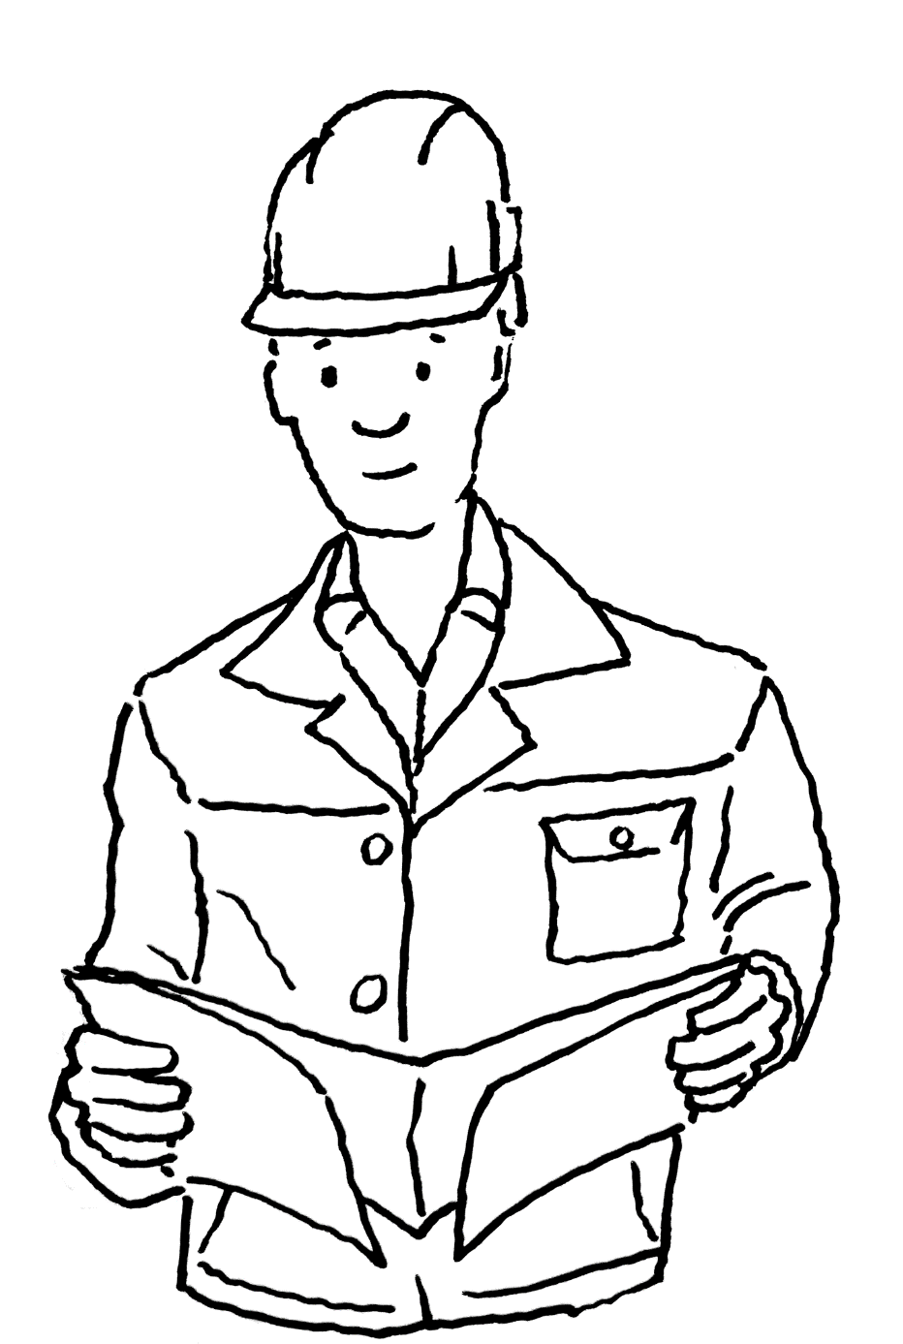

2. Reasons for the certification of individuals
Legal requirements
Government
Labour market
Ensuring quality
Employers
Employees

Slide 7

2. Reasons for the certification of individuals
Legal requirements – examples
Regulated professions
Practising of a craft trade which requires a licence
Specific technical activities in the craft trades
Tasks undertaken by experts
Immigration to Germany

Slide 8

2. Reasons for the certification of individuals
Impacts on the labour market
Transparency and mobility
Opportunities for advancement
Salary category grouping in the public sector
Collective bargaining agreements
Individual company-based regulations
Opportunity for higher-level vocational education and training (upgrading training)

Slide 9



2. Reasons for the certification of individuals
Certification is a tool for increasing the quality of initial and continuing VET
Regulatory requirements
Quality management systems
Government standards
Negotiated by policymakers
Involvement of social partners
Options for monitoring and intervention by stakeholders
Compulsory or voluntary
Compliance with standards
Transparency
Source: BIBB 2019

Slide 10
3. Certification in the German VET system
Two basic procedures
3.1 Certification based on regulatory requirements
State examinations
Examination by the competent body based on legal/ statutory requirements
3.2 Certification by certified/accredited organisations in the context of quality management systems
Based on legal requirements
Based on market requirements
Voluntarily

Slide 11
3. Certification in the German VET system
Two basic procedures
Certification
3.1
...based on regulatory requirements
State examinations
Examination by the competent body based on legal/statutory requirements
3.2
… by certified/accredited organisations in the context of quality management systems
Based on legal requirements
Based on market requirements
Voluntarily

Slide 12
3. Certification in the German VET system
3.1 Certification based on regulatory requirements
This is the common approach in the German VET system for examinations in the context of initial training and upgrading training. The examinations which take place are either state examinations or examinations through the “competent body”.
The following are determined by law or through regulation:
Responsibility:
Examination regulation
Examination organisation
Examination board
Examination requirements and admissions
Procedures and processes
Best practices

Slide 13
3. Certification in the German VET system
Examples of state examinations
Occupation | Training or further training | Regulatory requirements
General nurse | Initial VET | Law concerning nursing professions - Training and Examination Regulations for the Nursing Professions (PflAPrV)
Chemical technical assistant | Initial VET | Regulations in federal state law
State-certified technician | Advanced vocational training | Regulations in federal state law
State-certified business specialist | Advanced vocational training | Regulations in federal state law

Slide 14
3. Certification in the German VET system
Examples of examinations conducted by the competent body
Occupation | Training or further training | Regulatory requirements
Vocational training in the dual system | Initial VET | Vocational Training Act (BBiG), Crafts and Trades Regulation Code (HwO), training regulations, Recommendations from the BIBB board Competent bodies: Chambers of Industry and Commerce (IHK), Chambers of Crafts and Trades (HwK), other chambers establish examination boards
Master craftspersons | Advanced vocational training | Crafts and Trades Regulation Code, legal regulations of the German Federal Ministry for Economic Affairs and Climate Action (BMWK), master craftsperson examination boards are state examination authorities at the headquarters of the chambers of crafts and trades. The latter are consulted when the examination boards are established.
Business economist, IHK Business economist under the Crafts and Trades Regulation Code | Advanced vocational training | BBiG, HwO, Federal Office of Justice regulations

Slide 15
3. Certification in the German VET system
3.2 Certification by certified/accredited organisations in the context of quality management systems
Standards, regulations
Individuals
Accreditation body
accredits
Certification body
certifies
Organisations
Measures

Slide 16
3. Certification in the German VET system
3.2 Certification by certified/accredited organisations in the context of quality management systems based on legal requirements.
Examples:
Accreditation and licensing ordinance for employment promotion (AZAV) of the Federal Employment Agency. Since 2012, the Deutsche Akkreditierungsstelle (Dakks) has accredited “expert bodies”. These first certify the provider in accordance with AZAV requirements and then the relevant individual measures.
Due to building inspection regulations, welding work in steel construction must be carried out by certified companies and certified skilled workers. The basis for this is a comprehensive series of DIN-EN standards. In vehicle construction, these same standards are not binding but are demanded by the market.

Slide 17
3. Certification in the German vocational education and training system
Voluntary certification by certified/accredited organisations in the context of quality management systems
For non-government funded continuing training offers, whose participants receive no financial support or non-cash benefits, there are no legally binding stipulations in terms of quality assurance.
Quality assurance certificates however remain an important marketing tool for providers and have become a criterion for those interested in continuing vocational education training when making their decisions.
Quality management systems have also become accepted outside the publicly funded sector (2017 Continuing Training Monitor: 80% with QM system, 52% with certification)
There are a large number of QM systems for continuing education and training
Cost is the reason given for not using QM systems
Source: BIBB 2017 Continuing Training Monitor

Slide 18
4. Relevance to international VET cooperation (iBBZ)
Use of best practice
Choice of certification procedure
Legal requirements in the partner country
Certification with/without cooperation partner
Interests of the partner organisation
Costs and financing!
Impact on graduate opportunities in the labour market
Impact on potential labour migration
Germany:
Only qualifications recognised by the state in the partner country can go through the recognition procedure
In some circumstances, certificates from chambers of commerce abroad (AHKs) make residence permits possible.
Requirements of international employers

Slide 19
GOVET at BIBB

