Slide 1
The role of the chambers
in dual VET
Vocational education
and training
in Germany

Slide 2
Contents
Business Organisations
Responsibilities and functions of the chambers
Examples

Slide 3
1. Business Organisations
Chambers
Professional associations/employer organisations
Cross-sectoral organisations, in most cases operating at regional level in the different economic sectors (industry
and commerce, craft trades, agriculture, liberal professions)
Compulsory membership, representation of all companies
Public body
Self-governing
State exercises legal supervision (in some cases technical supervision)
Financing: contributions, fees, revenues from services
Organisations come together to form bodies at federal-state and national level
Sector-specific organisations from district to national level
Voluntary membership
Generally organisations under private law
  Exceptions: guilds and district craftsmen's associations (public bodies)
Funding: voluntary contributions, revenues from services
Representation of employers as one of the two social partners.

Slide 4
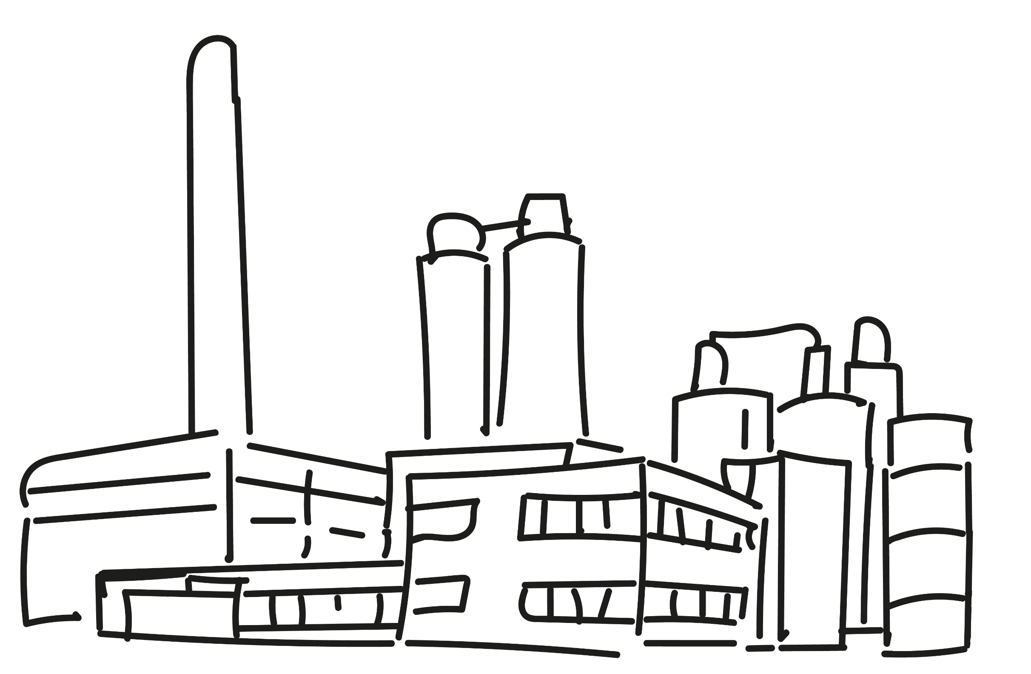
1. Business Organisations
Self-governance of the economy
Exists for companies engaged in commerce, industry, agriculture, the crafts and trades, and for members of the liberal professions (doctors, lawyers, architects, accountants, etc.)
Specific, clearly defined public administration responsibilities are transferred to public bodies: decentralisation of administrative tasks
State supervises the legality, usually not the expediency of the measures (legal supervision, in some cases technical supervision)
Compulsory membership, representation of all companies
Democratic structures: companies have control via general assembly and election of the Executive Board and the President

Slide 5
1. Business Organisations
+
Chamber organisation. Fulltime and honorary office
Chief Executive
President
Fulltime office:
Management and personnel functions of the chambers
Honorary office:
President and presidency (executive board), general assembly, participation in examination boards, vocational education and training committee and other committees
represent IHK externally
support and implement policy
Example:
IHK
prepare resolutions
Employees
Presidency
Vice Presidents
balance interests
and take decisions
General Assembly
Committees
Working groups and networks
Figure: Based in “Das ist die IHK Darmstadt Rhein Main Neckar” [Here's Darmstadt Rhein Main Neckar IHK], https://www.ihk.de/darmstadt/servicemarken/ueber-uns/grafik-organisation-gross-5023834
Member companies

Slide 6



2. Responsibilities and functions of the chambers
Overview
Monitoring and regulation of vocational edu-cation and training in their area of responsi-bility in their role as “competent bodies”
Deciding on elements of company- based training to be organised as
inter-company trainee instruction
and often implementing this themselves
in their vocational training centres
Institutionalised dialogue between stake-holders via vocational education and training committees
Advising companies, acting as intermediary between trainees and companies
Acting as intermediary between state institutions (government, labour administration, schools, universities) and companies
Representing interests of companies
Running vocational training centres
Quality initiatives

Slide 7

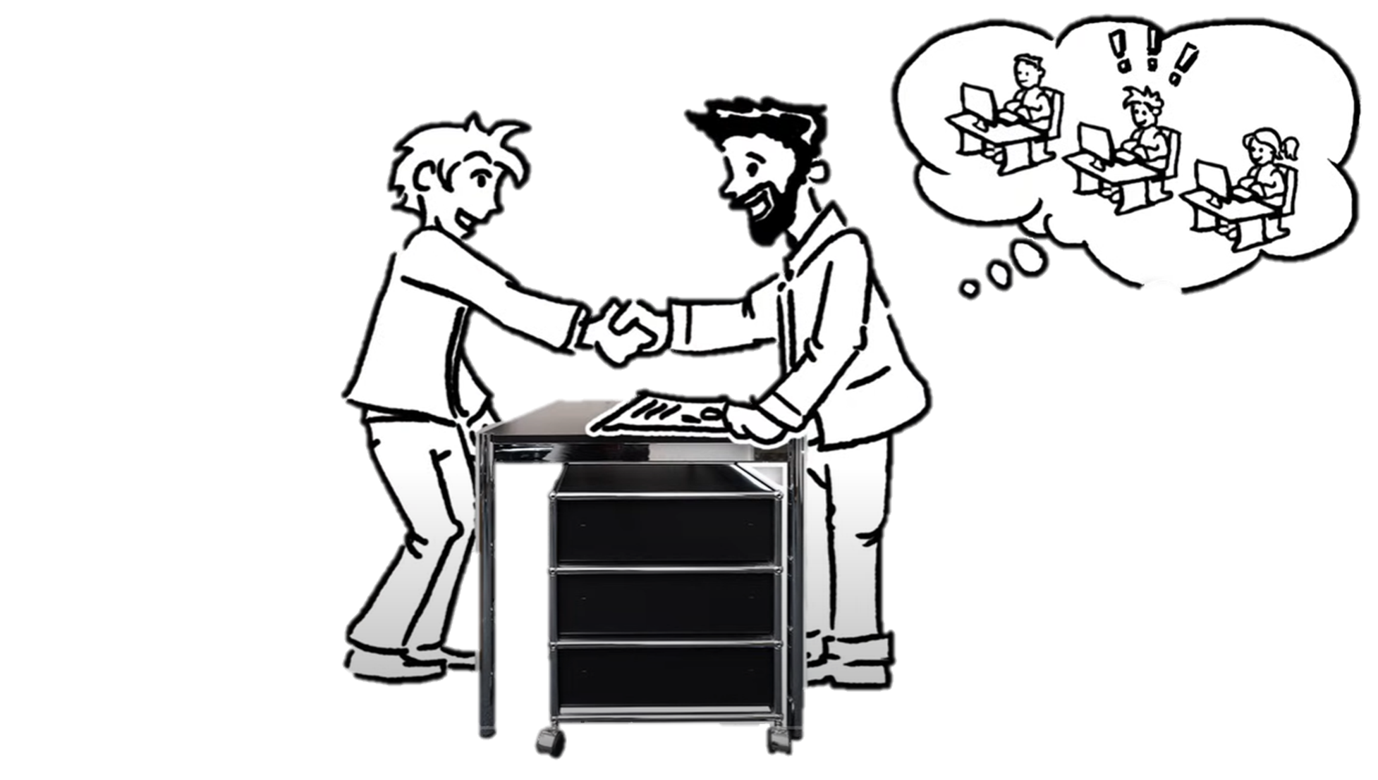
2. Responsibilities and functions of the chambers
Competent body
The Competent body is defined by law
  usually the chambers
  in some cases it is a state authority
Monitoring of pre-vocational education and training, vocational education and training,
and vocational retraining
Determines the suitability of companies and training personnel to provide training
Registration of all training contracts
Organisation of examinations, setting up of examination boards
Notes:
Further information:
The competent body is defined by law; these are usually the chambers but can also be state authorities, e.g. if there is no chamber of agriculture

Slide 8

2. Responsibilities and functions of the chambers
Competent body
Adoption of further education and training regulations and further education and training examination regulations
Setting up of vocational training committees
Recognition of professional qualifications obtained abroad
Chambers in the crafts trades may assign examination
responsibilities to guilds and district craftsmen's associations,
i.e. representatives of sectors

Slide 9
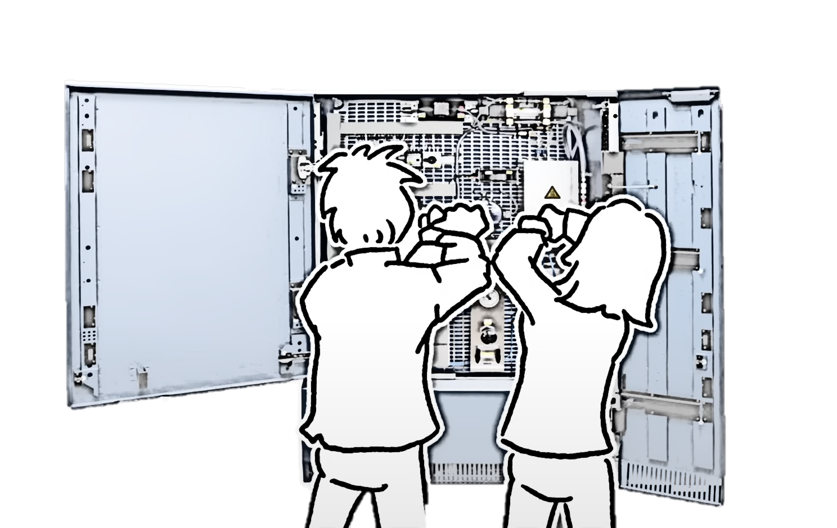
2. Responsibilities and functions of the chambers
Vocational training centres
The chambers run approx. 1,000 vocational training centres nationwide
Running costs are financed by the chambers
Government-funded investment in some cases
Main emphasis in the craft trades
Responsible for:
  Inter-company trainee instruction.
  Continuing training
  Testing of new technologies/procedures
  Guidance for companies

Slide 10
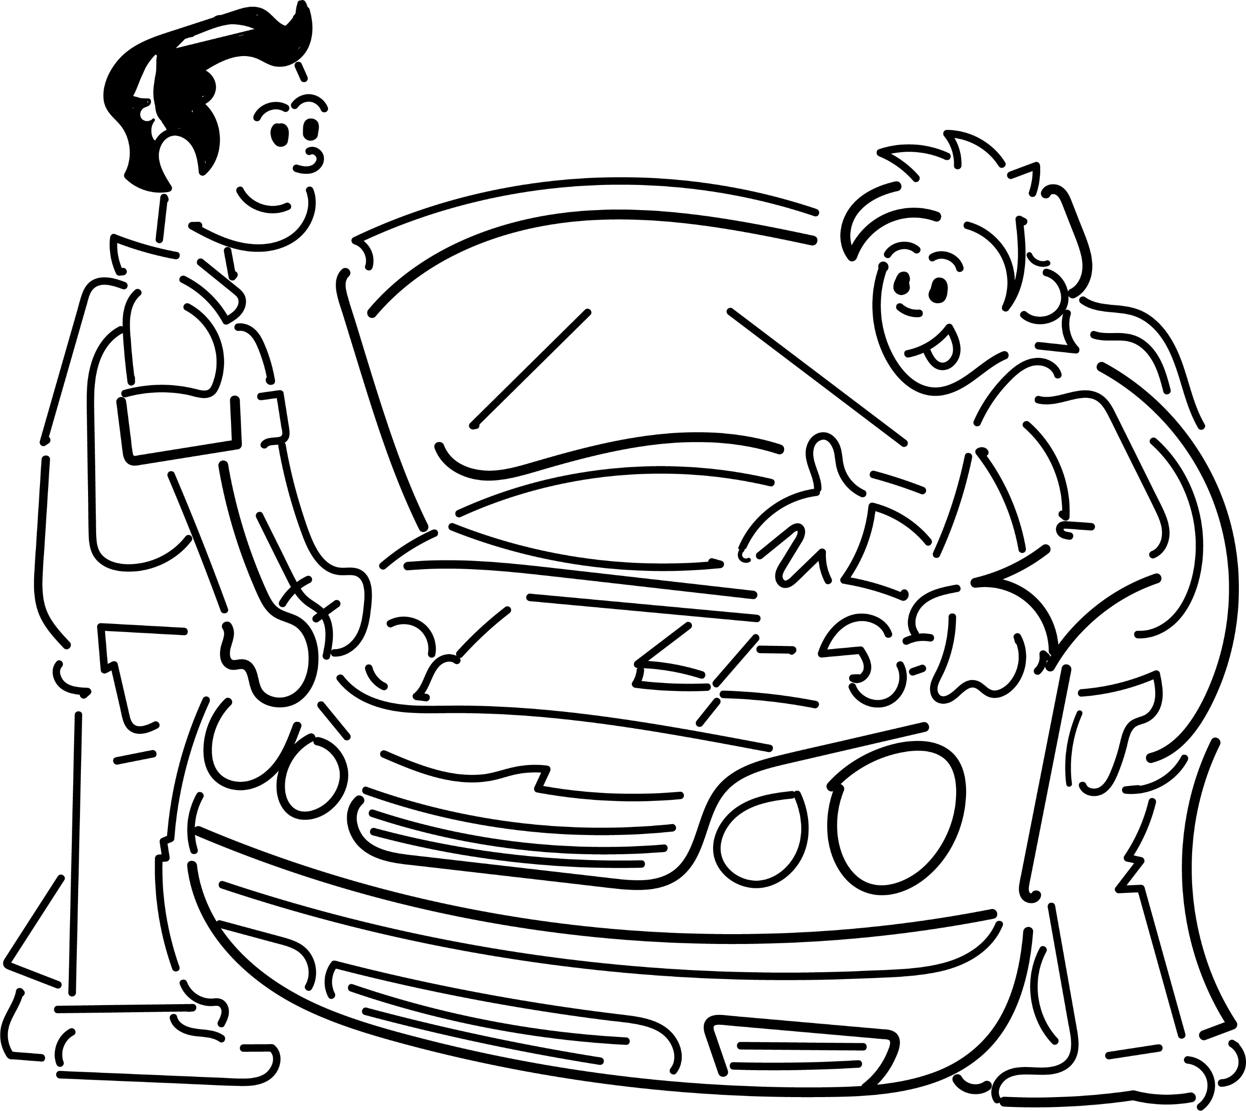
2. Responsibilities and functions of the chambers
Inter-company trainee instruction
Main emphasis in the craft trades
Supplementing training with courses lasting several days to several weeks
Teaching of know-how in theory and in practice
Financed by training companies with additional funding from the federal
government and federal states
Consolidation and systematization of VET, independent of the company and
its specific production process
Ensuring the quality and mobility of workers
Transfer of technology

Slide 11
2. Responsibilities and functions of the chambers
Involvement in the governance of the vocational education and training system
Involvement in bodies at all levels:
  There is no hierarchical relationship between the various committees; the committees fulfil their respective legal obligations independently of one another
Involvement in the development of training regulations via the umbrella organizations and through the provision of experts
Involvement in pilot projects, testing of new concepts and processes
Vocational education and training committees
Managed by chambers, at regional level
Federal state committees for vocational education and training
Involvement of chambers and chamber organisations across the federal state, at federal state level
Board of the Federal Institute for Vocational Education and Training (BIBB)
Umbrella organisation of the German Chambers of Industry and Commerce (DIHK) and the German Confederation of Skilled Crafts (ZDH), at national level

Slide 12
2. Responsibilities and functions of the chambers
Vocational education and training committee
Managed by chambers at regional level
Federal state committees for vocational education and training
Involvement of chambers and chamber organisations across the federal state, at federal state level
Board of the Federal Institute for Vocational Education and Training (BIBB)
Umbrella organisation of the German Chambers of Industry and Commerce (DIHK) and the German Confederation of Skilled Crafts (ZDH), at national level
Regional body
Managed by the chamber
Members are appointed by the competent federal state authority
  Six employee representatives, proposed by trade unions
  Six members of teaching staff at vocational schools, proposed by the competent federal state authority
  Six employer representatives, proposed by the chamber
  Six deputies in each case
Role is voluntary/honorary

Slide 13
2. Responsibilities and functions of the chambers
Vocational education and training committee
Managed by chambers at regional level
Federal state committees for vocational education and training
Involvement of chambers and chamber organisations across the federal state, at federal state level
Board of the Federal Institute for Vocational Education and Training (BIBB)
Umbrella organisation of the German Chambers of Industry and Commerce (DIHK) and the German Confederation of Skilled Crafts (ZDH), at national level
Responsibility: contributing to continuous development of quality in vocational education and training
Must be notified and consulted on all important matters relating to vocational education and training, e.g.
  Building of inter-company training centres
  New forms of vocational education and training and new VET content
  Statements made to authorities
Making decisions, including on legal provisions of the competent body (e.g. examination regulations)
  Agreement from additional chamber bodies may be needed for decisions with budgetary implications

Slide 14
2. Responsibilities and functions of the chambers
Vocational education and training committee
Managed by chambers at regional level
Federal state committees for vocational education and training
Involvement of chambers and chamber organisations across the federal state, at federal state level
Board of the Federal Institute for Vocational Education and Training (BIBB) Umbrella organisation of the German Chambers of Industry and Commerce (DIHK) and the German
Confederation of Skilled Crafts (ZDH), at national level
Set-up in accordance with Section 82 of the Vocational Training Act (BBiG) in each federal state
Equal numbers of representatives of employers, employees and supreme state authorities.
Role is voluntary/honorary
Chambers propose some of the members
Responsibilities:
  Advising the federal state government on vocational education and training issues
  Contributing to:
  the continuous development of the quality of vocational education and training
  cooperation between school-based and dual vocational education and training
  ensuring vocational education and training is taken into account in the reorganisation and further development of the school system

Slide 15
2. Responsibilities and functions of the chambers
Vocational education and training committee
Managed by chambers at regional level
Federal state committees for vocational education and training
Involvement of chambers and chamber organisations across the federal state, at federal state level
Board of the Federal Institute for Vocational Education and Training (BIBB)
Umbrella organisation of the German Chambers of Industry and Commerce (DIHK) and the German Confederation of Skilled Crafts (ZDH), at national level
Equal numbers of representatives of employers, employees, the federal government and the federal states.
Some of the employer representatives are seconded by the chamber organisations
Responsibilities:
  advising the federal government on basic issues relating to vocational education and training
  may submit an opinion on the federal government's draft annual Report on Vocational Education and Training
  determines BIBB's yearly and medium-term research programme
  makes recommendations on supporting and developing vocational education and training
  determines BIBB's budget

Slide 16

2. Responsibilities and functions of the chambers
Vocational education and training committee
Managed by chambers at regional level
Federal state committees for vocational education and training
Involvement of chambers and chamber organisations across the federal state, at federal state level
Board of the Federal Institute for Vocational Education and Training (BIBB) Umbrella organisation of the German Chambers of Industry and Commerce (DIHK) and the German Confederation of Skilled Crafts (ZDH), at national level
Federal Government
5 representatives
8 votes
Employers
8 representatives
8 votes
Federal states
8 representatives
8 votes
Employees
8 representatives
8 votes
Advisory capacity:
1 representative from the Federal Employment Agency (BA)
1 representative of central municipal organisations

Slide 17
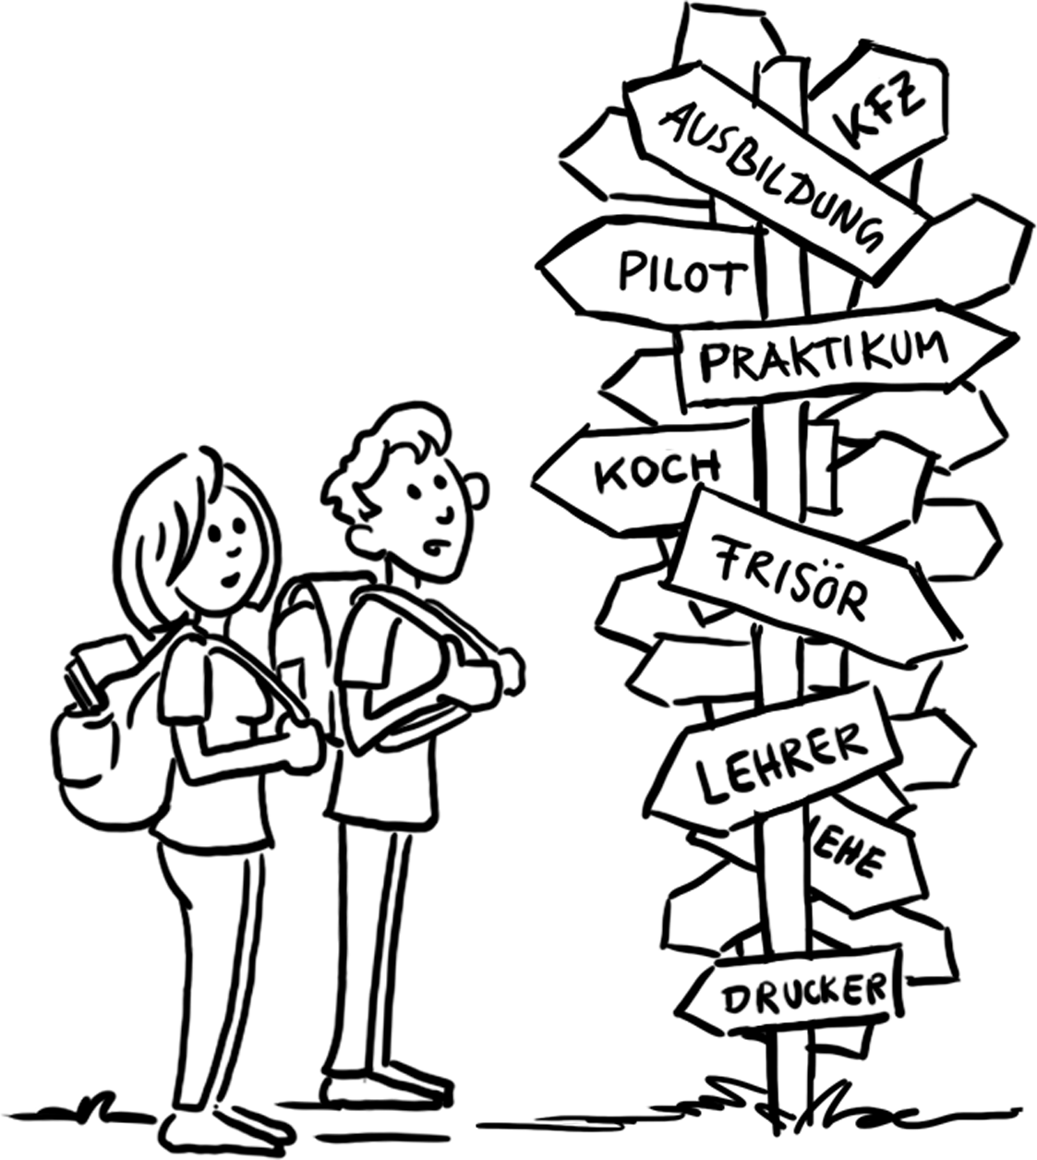
2. Responsibilities and functions of the chambers
Supporting the regional economy
Guidance for companies on starting and carrying out training
Mediating in the case of disputes
Providing information to the general public, teachers, pupils, parents, etc
Advising young people, parents and trainees
Involvement in career orientation
Organisation of pre-vocational training
Organisation of training position marketplaces, online and in the region

Slide 18

2. Responsibilities and functions of the chambers
Quality initiatives
All chambers help to develop the quality of company-based training
100 out of around 130 IHKs and chambers of crafts and trades implement quality initiatives
Measures for further developing, ensuring or recognising quality in company-based training
Events of various types
Seals, certificates for recognising companies
Chamber information materials
Schools and workshops
Consultations

Slide 19
3. Examples
Chamber of Industry and Commerce (IHK)
79 IHKs nationwide
Regulated in the “Law temporarily regulating the chambers of commerce and industry” (IHKG)
One of the duties under Section 1 of the IHKG: Measures to promote and implement commercial and industrial vocational education and training
Competent body for vocational education and training in industrial and commercial occupations other than those of the crafts and trades in accordance with Section 72(2) of the Vocational Training Act (BBiG)
170.915 companies providing training (2022)
688.125 training contracts (2023)
27,283 examination boards with 181,971 members (2019)
IHK organisation: Chamber of Industry and Commerce (IHKs), German Chambers of Commerce Abroad (AHKs), German Chamber of Industry and Commerce (DIHK)
Sources: IHK, DIHK; 2023

Slide 20






3. Examples
Chamber of Industry and Commerce (IHK)
AHKs
DIHK
IHKs
Platform and service provider for
dual vocational education and training abroad
Guidance, organisation, quality assurance
IHK cooperation partner
Strategy/network coordination/
cooperation
Training products/project service/
AHK services
Quality management for DIHK, AHKs, IHKs
Administration and provider of know-how
Competent body for vocational education and training
in Germany
AHK cooperation partner

Slide 21



3. Examples
Funding of chambers of commerce and industry
Commercial accounting
Main revenue items: contributions from companies, fees for services
Main expenditure items: personnel costs
Budget (forecast profit and loss), contribution level and borrowing decided by General Assembly (economic statute)
Contributions based on the profitability of companies and in some cases legal form: fixed basic contribution plus tiered variable contribution, micro businesses are generally exempt
Average contribution for companies which pay is €448 p.a., average contribution for companies entered in the commercial register is €614 (2022)

Slide 22

3. Examples
German Chambers of Commerce Abroad
Usually organised under private law, in some cases not-for-profit
Organisations which control their own commercial affairs (economic self-governance)
Supported by member companies based abroad and in Germany
Voluntary membership, not chambers in the narrower sense of the word, not regulated by law
150 AHKs in 93 countries
Varied responsibilities, particularly in the area of foreign trade
Financed by membership contributions and remuneration for services
Funded by the Federal Ministry for Economic Affairs and Climate Action (BMWK)
Growing number are organising dual VET in line with the German model

Slide 23
3. Examples
Chambers of crafts and trades
Regulated in the Crafts and Trades Regulation Code (HwO), responsibilities in vocational education and training are outlined in Section 91 of the HwO
53 chambers of crafts and trades across Germany
Employees and trainees also represented in the craft trades (one-third parity rule in the bodies)
Competent body for vocational education and training in occupations under the Crafts and Trades
Regulation Code in accordance with Section 72(1) of the Vocational Training Act (BBiG)
342.561 training contracts (2023)
Organisation of craft trades:
  Chambers of crafts and trades are organised at federal-state level into regional associations of German chambers of crafts and trades.
  They are confederated at national level in the Association of German Chambers of Crafts and Trades (Deutscher Handwerkskammertag, DHKT) and are also members of the German Confederation of Skilled Crafts (Zentralverband des Deutschen Handwerks, ZDH) together with the trade associations of the craft trades

Slide 24
3. Examples
Overview of the organisation of the craft trades
German Confederation of Skilled Crafts
FEDERAL LEVEL
Association of German Chambers of Crafts and Trades
German Association of Skilled Crafts Confederations
Commercial and other organisations
41 Central trade associations
FEDERAL STATE LEVEL
14 Regional federations of state associations
13 Regional chamber associations
14 State craft trade agencies
368 State trade and guild associations
REGIONAL LEVEL
53 Chambers of crafts and trades
DISTRICT LEVEL
253 District craftsmen's association
4,361 Trade guilds
1,037,073 Craft trade businesses (all annexes) with around 5.61 million employees
Membership Legal supervision
Source: ZDH, 2023

Slide 25
3. Examples
Financing of chambers of crafts and trade
Commercial or governmental accounting
Main revenue items:
  Company contributions
  Fees for services, in particular course fees (especially master craftsperson courses and inter-company training) and examination fees
Main expenditure items: personnel costs, training centre personnel account for a large share of this
Contributions based on earnings potential of companies: fixed basic contribution plus tiered variable contribution dependent on earnings

Slide 26
3. Examples
Other chambers
Agricultural occupations
Occupations in the administration of justice
Chambers of agriculture (do not exist nationwide)
If there is no chamber of agriculture, responsibility for VET rests with the state administration of agriculture, generally at federal state level
28 regional bar associations
One national bar association, one chamber of patent attorneys and 21 chambers of notaries (organised into one national chamber of notaries)
Occupations in auditing and tax consultancy
Healthcare occupations
One chamber of public accountants
21 chambers of tax consultants and their umbrella organisation, the national chamber of tax consultants
Medical councils, chambers of dentists, veterinary surgeons and dispensing chemists

Slide 27
GOVET at BIBB

